Slide 1



803400815101 Blockchain and Smart Contracts Artificial Intelligence Technologies Program (Graduate) Graduate School of Natural and Applied Sciences 2023 - 2024 Spring Semester
Smart Contracts: Architecture and Development
Göksu ŞENTÜRK
Fatih BİLDİRİCİ
goksusenturk0@gmail.com
fatihbildirici.dev@gmail.com .

Slide 2
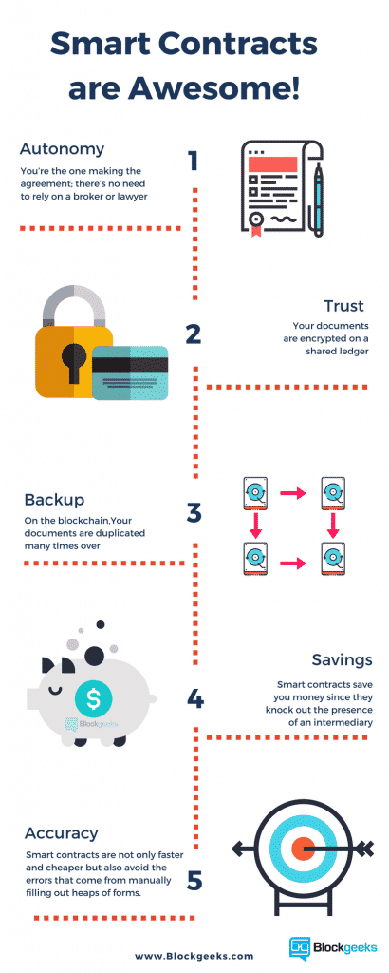
What Are Smart Contracts?
Smart contracts are self-executing contracts with the terms of the agreement directly written into code. These contracts are executed and enforced automatically when predefined conditions are met, without the need for intermediaries like lawyers or banks. Smart contracts run on blockchain technology, which ensures transparency, security, and immutability.
Smart contracts have a wide range of use cases, including financial transactions, supply chain management, voting systems, digital identity verification, and more. They are particularly popular in decentralized finance (DeFi) applications.
Notes:
FATİH

Slide 3
What Are Smart Contracts?
Some key points about smart contracts:
Self-executing: Once deployed on the blockchain, smart contracts automatically execute their terms when specific conditions are met. This automation reduces the need for manual intervention.
Code-based: Smart contracts are written in programming languages specifically designed for them, such as Solidity for Ethereum. The contract's logic is encoded into the code, ensuring accuracy and consistency in execution.
Blockchain-based: Smart contracts operate on blockchain platforms like Ethereum. This means that contract execution and data storage are decentralized and distributed across the blockchain network, enhancing security and trust.
Notes:
FATİH

Slide 4
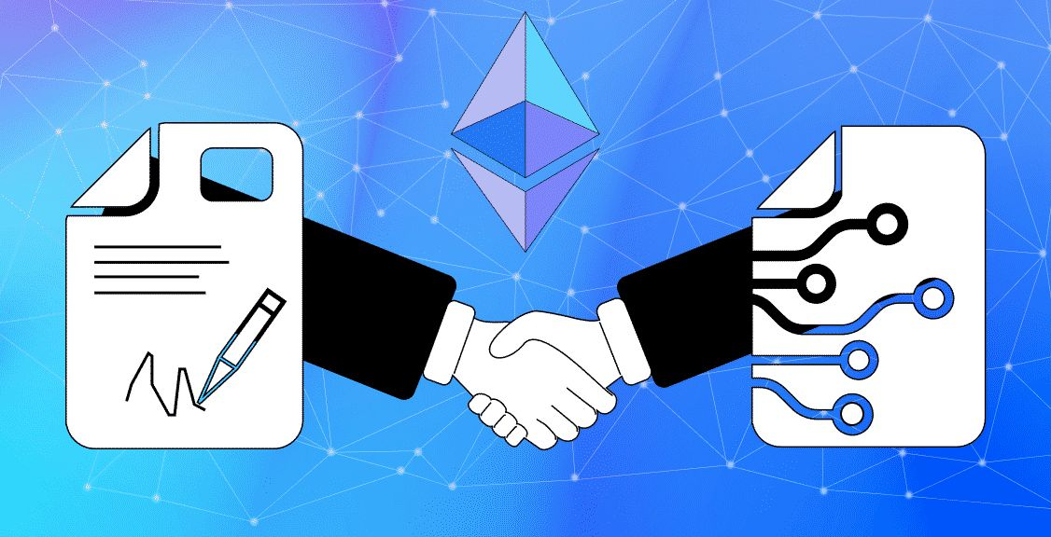
What Are Smart Contracts?
4. Transparency: Since smart contracts are deployed on a public blockchain, their code and execution history are visible to all participants. This transparency builds trust among parties involved in the contract.
5. Security: Blockchain's cryptographic techniques ensure that smart contracts are tamper-proof and resistant to fraud. Once deployed, a smart contract's code cannot be altered without consensus from the network.
6. Immutability: Smart contracts are immutable, meaning their code and execution history cannot be changed retroactively. This feature ensures that contract terms are upheld and prevents disputes.
Notes:
FATİH

Slide 5
Smart Contract Platforms
Smart contract platforms, such as Ethereum, provide the infrastructure and environment for creating, deploying, and executing smart contracts. These platforms offer tools, protocols, and networks that developers can utilize to build decentralized applications and execute smart contracts seamlessly.
Ethereum is one of the most well-known and widely used smart contract platforms, but there are others as well, each with its unique features and capabilities. Other platforms:
Binance Smart Chain (BSC)
Polkadot
Cardano
Tezos
Solana
Avalanche
Notes:
GÖKSU

Slide 6

Smart Contract Platforms - Ethereum
Ethereum is a blockchain platform that enables developers to build and deploy smart contracts and dApps. It introduced the concept of a Turing-complete scripting language (Solidity) for writing smart contracts, allowing for complex logic and functionality.
Smart Contract Deployment: Platforms like Ethereum provide the infrastructure for deploying smart contracts on the blockchain. Developers can deploy their contracts using tools like Remix (an online Solidity IDE) or Truffle (a development framework).
Blockchain Integration: Smart contract platforms are integrated with blockchain technology, which ensures decentralized and secure execution of contracts. Ethereum, for instance, uses a consensus mechanism called Proof of Work (PoW) (transitioning to Proof of Stake with Ethereum 2.0) to validate transactions and execute smart contract code.
Notes:
GÖKSU

Slide 7
Smart Contract Platforms - Ethereum
Gas Fees: Ethereum and similar platforms require users to pay gas fees for executing smart contracts. Gas fees represent the computational resources required for contract execution and help prevent spam and abuse on the network.
Interoperability: Smart contract platforms may support interoperability with other blockchains and protocols. Ethereum, for example, has initiatives like Ethereum Virtual Machine (EVM) compatibility and Ethereum Name Service (ENS) to enhance interoperability.
Decentralized Finance (DeFi): Ethereum is widely used in the DeFi space, hosting a variety of financial applications like decentralized exchanges (DEXs), lending protocols, yield farming platforms, and more. These applications leverage smart contracts for automated and trustless financial transactions.
Scalability Challenges: One of the ongoing challenges for smart contract platforms like Ethereum is scalability. As the network grows, issues such as high transaction fees and network congestion can arise. Solutions like layer 2 scaling solutions and Ethereum 2.0 aim to address these scalability challenges.
Notes:
GÖKSU
Overall, smart contract platforms like Ethereum play a crucial role in enabling decentralized applications, token economies, and innovative use cases in the blockchain space. They provide the infrastructure for secure, transparent, and programmable contracts that can revolutionize various industries.

Slide 8

Coding Smart Contracts
Coding smart contracts involves writing computer code that defines the logic and behavior of the contracts.
Smart contracts are typically written in specific programming languages designed for blockchain development, with Solidity being one of the most popular languages used for coding smart contracts on platforms like Ethereum.
Smart contracts are written in programming languages specifically designed for blockchain development.
These languages often have features that facilitate interacting with blockchain data and executing transactions.
Smart contract code defines the rules, conditions, and actions that govern the behavior of the contract.
Contracts are deployed to the blockchain, where they execute autonomously based on predefined conditions.
Notes:
FATİH

Slide 9
Coding Smart Contracts (e.g., Solidity)
Solidity is a high-level programming language designed for writing smart contracts on Ethereum and other compatible blockchain platforms. Here are some key points about Solidity:
Syntax: Solidity syntax is similar to JavaScript and C++, making it relatively easy for developers to learn and use.
Data Types: Solidity supports various data types such as integers, booleans, strings, arrays, structs, and more.
Functions: Smart contracts in Solidity are made up of functions that define the contract's behavior. Functions can be public, private, or internal.
State Variables: Solidity allows the declaration of state variables that persist on the blockchain and hold contract data.
Modifiers: Modifiers in Solidity are used to add conditions or restrictions to functions, enhancing security and control.
Events: Solidity supports events, which are used to log important contract actions and provide transparency.
Inheritance: Solidity supports inheritance, allowing contracts to inherit properties and functions from other contracts.
Deployment: Once a smart contract is written in Solidity, it is compiled into bytecode and deployed to the Ethereum blockchain using tools like Remix or Truffle.
Notes:
FATİH

Slide 10
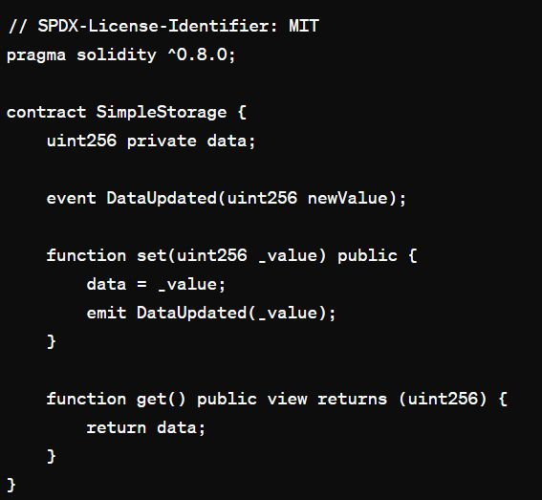
Solidity- Example
This simple smart contract is a storage contract and basically performs the following functions:
set(uint256 _value): This function takes the _value parameter and assigns this value to a private variable named data. It also triggers the DataUpdated event and includes the _value parameter to transmit the new value.
get(): This function returns the current value of data. This function is marked with the view specifier, which means it won't modify the blockchain and only allows reading the state.
This simple example demonstrates how a smart contract is written and how its functionalities are implemented. This contract can be used to store and retrieve data. Specifically, the set function triggers an event to track data changes, allowing contract users to monitor and verify transactions.
Notes:
FATİH
// SPDX-License-Identifier: MIT
pragma solidity ^0.8.0;
contract SimpleStorage {
uint256 private data;
event DataUpdated(uint256 newValue);
function set(uint256 _value) public {
data = _value;
emit DataUpdated(_value);
}
function get() public view returns (uint256) {
return data;
}
}

Slide 11

Execution and Automation of Smart Contracts
Execution and automation are crucial aspects of smart contracts and blockchain technology.
Execution of Smart Contracts:
Smart contracts are executed when predefined conditions coded into their logic are met.
Execution involves processing transactions, updating contract states, and triggering events as defined in the contract's code.
Smart contract execution occurs on the blockchain network where the contract is deployed, ensuring transparency and immutability.
Automation in Smart Contracts:
Automation refers to the ability of smart contracts to self-execute without the need for human intervention.
Once deployed, smart contracts autonomously perform predefined actions based on input data and contract conditions.
Automation eliminates intermediaries, reduces costs, and improves the efficiency of transactions and processes.
Notes:
GÖKSU
Overall, execution and automation are fundamental aspects of smart contracts that enable efficient, transparent, and trustless transactions and processes on blockchain networks. However, careful consideration of security, scalability, compliance, and testing is necessary to harness the full potential of smart contracts while mitigating risks.

Slide 12

Execution and Automation of Smart Contracts
3. Benefits of Execution and Automation:
Accuracy: Smart contracts execute transactions and processes precisely according to coded rules, reducing errors and disputes.
Transparency: Execution on a blockchain provides transparent and auditable records of contract execution and outcomes.
Efficiency: Automation streamlines processes, reduces manual intervention, and speeds up transaction settlement.
Cost Savings: Eliminating intermediaries and automating processes result in cost savings for parties involved.
Trust: Automation based on predefined rules and blockchain technology enhances trust among participants by ensuring contract terms are upheld.
4. Challenges and Considerations:
Security: Ensuring smart contract security is crucial to prevent vulnerabilities and potential exploits.
Scalability: As blockchain networks grow, scalability becomes important to handle increased transaction volumes efficiently.
Legal and Regulatory Compliance: Smart contracts must comply with legal requirements and regulations, which may vary across jurisdictions.
Testing and Auditing: Thorough testing and auditing of smart contract code are essential to identify and address potential issues before deployment.
Notes:
GÖKSU
Overall, execution and automation are fundamental aspects of smart contracts that enable efficient, transparent, and trustless transactions and processes on blockchain networks. However, careful consideration of security, scalability, compliance, and testing is necessary to harness the full potential of smart contracts while mitigating risks.

Slide 13
Privacy and Security in Blockchain and Smart Contracts: Privacy Challenges
Transparent Ledger: Blockchain's transparent nature means that transaction details are visible to all network participants, posing challenges for data privacy.
Pseudonymity: While blockchain addresses are pseudonymous, they can still be traced back to real-world identities, raising privacy concerns.
Data Protection: Storing sensitive data directly on the blockchain can expose it to unauthorized access, requiring privacy-enhancing techniques.
Notes:
FATİH Privacy and security are critical aspects of blockchain technology and smart contracts. Let's delve into each of these topics

Slide 14

Privacy and Security in Blockchain and Smart Contracts: Zero-Knowledge Proofs
Zero-knowledge proofs allow one party (the prover) to prove the validity of a statement to another party (the verifier) without revealing any additional information other than the statement's truth. In other words, ZKPs enable the verification of knowledge or data without disclosing the actual content of that knowledge or data.
Use Cases: ZKPs can be used in blockchain to validate transactions without disclosing sensitive data, such as verifying ownership without revealing the actual asset.
Components of Zero-Knowledge Proofs:
Statement: The assertion that the prover wants to prove to the verifier (e.g., knowledge of a secret, possession of a credential).
Proof: The cryptographic proof generated by the prover to demonstrate the truthfulness of the statement.
Verification: The process by which the verifier checks the validity of the proof without learning anything beyond the statement's truthfulness.
Two Types of Zero-Knowledge Proofs:
Interactive Zero-Knowledge Proofs: These require interaction between the prover and verifier to generate and verify the proof.
Non-Interactive Zero-Knowledge Proofs (NIZKPs): These allow for the generation of proofs that can be verified without direct interaction between the prover and verifier.
Notes:
FATİH
The concept of zero-knowledge proofs was introduced in the field of cryptography to address the challenge of proving information or credentials without compromising privacy.
Overall, Zero-Knowledge Proofs play a crucial role in enhancing privacy, security, and trust in various domains by allowing for confidential transactions and verifiable computations without revealing sensitive information.

Slide 15
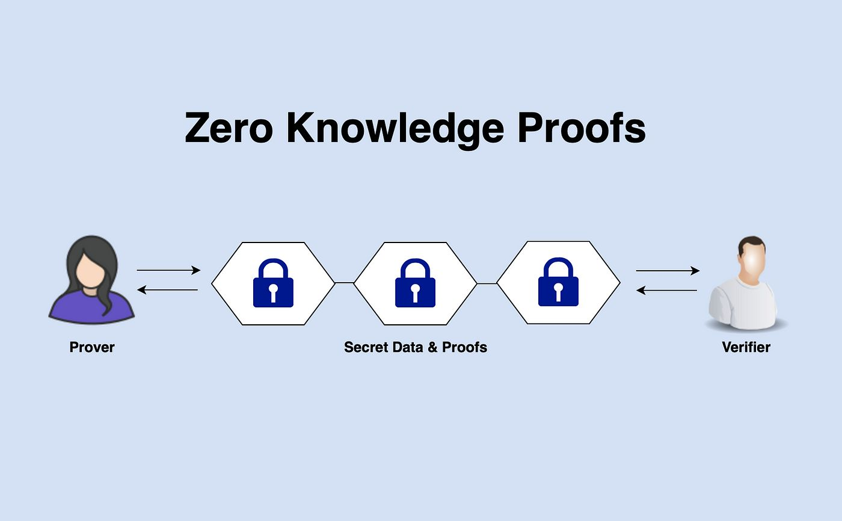
Privacy and Security in Blockchain and Smart Contracts: Applications of Zero-Knowledge Proofs:
Blockchain and Cryptocurrencies:
Private Transactions: ZKPs are used in privacy-focused cryptocurrencies like Zcash and Monero to enable private transactions. In these systems, ZKPs allow users to prove the validity of transactions without revealing the sender, recipient, or transaction amount.
Confidential Asset Transfers: ZKPs can be applied to blockchain platforms to enable confidential asset transfers. For example, in a supply chain scenario, ZKPs can hide sensitive information about product prices or quantities while still ensuring the integrity of the transfer process.
Notes:
FATİH

Slide 16
Privacy and Security in Blockchain and Smart Contracts: Applications of Zero-Knowledge Proofs:
Identity Verification:
Credential Verification: ZKPs can be used for verifying credentials without disclosing the actual credentials themselves. For instance, in a digital identity system, a user can prove they are over 18 years old without revealing their exact date of birth.
Anonymous Authentication: ZKPs enable anonymous authentication, where users can prove their identity or membership in a group without revealing their identity details. This can be useful in privacy-sensitive applications such as voting systems or access control protocols.
Notes:
FATİH

Slide 17
Privacy and Security in Blockchain and Smart Contracts: Applications of Zero-Knowledge Proofs:
Data Privacy:
Secure Data Sharing: ZKPs can facilitate secure data sharing by proving the correctness of computations or data manipulations without disclosing the actual data being processed. For example, in healthcare, ZKPs can be used to verify the accuracy of computations on sensitive patient data without exposing the data itself.
Auditability and Compliance: ZKPs can enhance auditability and compliance in data privacy regulations. Organizations can prove compliance with data protection laws without revealing sensitive customer information, ensuring both privacy and regulatory adherence.
Secure Multi-Party Computations (MPC):
Collaborative Data Analysis: ZKPs enable secure multi-party computations where multiple parties can jointly perform computations on their private data without sharing the raw data. This is beneficial in collaborative research or analysis while maintaining data privacy.
Notes:
FATİH

Slide 18
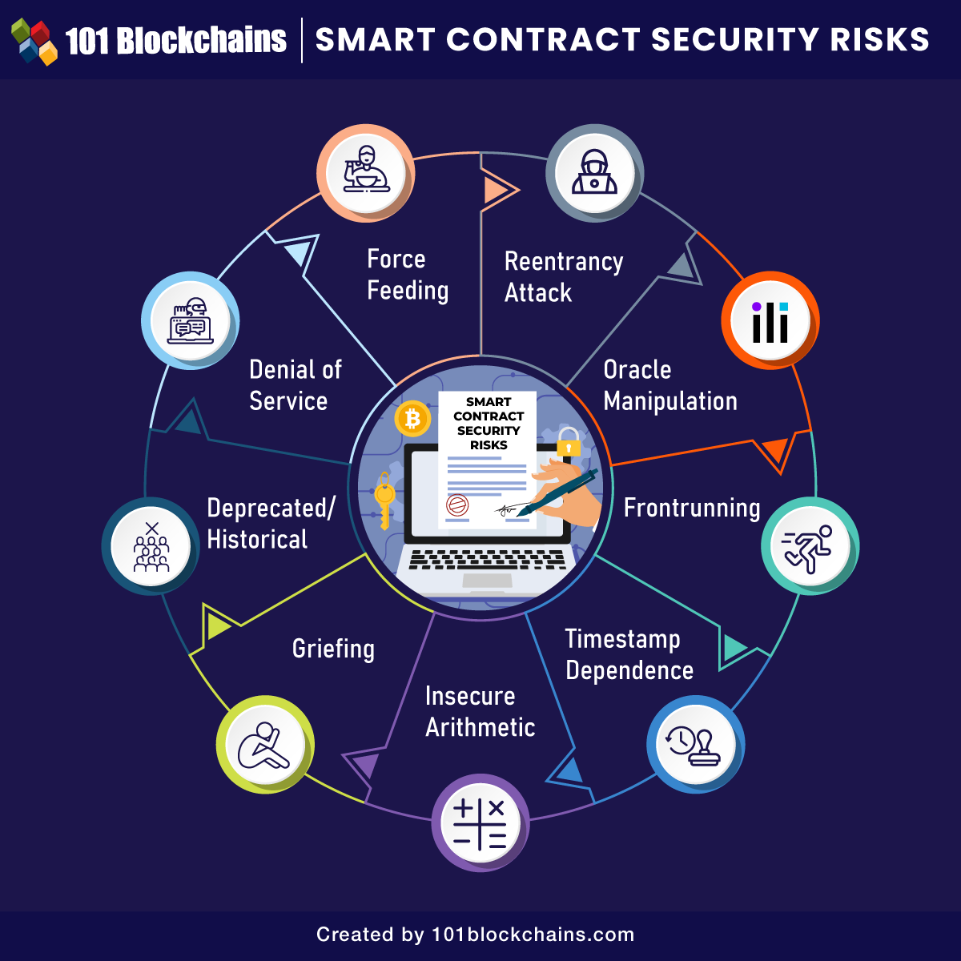
Privacy and Security in Blockchain and Smart Contracts: Smart Contract Security
Smart contract security is a critical aspect of blockchain technology, especially in decentralized applications (dApps) and platforms like Ethereum. Ensuring the security of smart contracts is essential to prevent vulnerabilities, attacks, and financial losses. Here are key considerations and best practices for smart contract security:
Code Auditing: Conduct thorough code reviews and audits by experienced developers and security experts to identify potential vulnerabilities, bugs, and logic flaws in smart contracts. Use automated tools and manual checks to assess code quality and security.
Secure Development Practices: Follow secure coding practices such as input validation, proper data handling, avoiding hardcoding sensitive information, and using secure libraries and frameworks. Use standardized coding conventions and patterns to improve code readability and maintainability.
Testing: Implement comprehensive testing strategies, including unit testing, integration testing, and stress testing, to validate smart contract functionality and identify edge cases and vulnerabilities. Test contracts in different network environments (e.g., testnet, mainnet) to simulate real-world conditions.
Notes:
GÖKSU
By implementing these security considerations and best practices, developers and organizations can enhance the security posture of their smart contracts, mitigate risks, and build trust with users in blockchain-based applications and platforms. Ongoing monitoring, audits, and security updates are also crucial to adapt to evolving threats and vulnerabilities in the blockchain ecosystem.

Slide 19
Privacy and Security in Blockchain and Smart Contracts: Smart Contract Security
4. Access Controls: Implement access controls and permission management to restrict sensitive functions and data access to authorized users or contracts. Use role-based access controls (RBAC) and require proper authentication for critical operations.
Secure External Calls: Be cautious when interacting with external contracts, APIs, or oracles. Use secure communication protocols, validate input data, and implement checks to prevent unauthorized or malicious calls that can exploit vulnerabilities.
Gas Limit Management: Manage gas limits and optimize contract design to avoid out-of-gas errors and denial-of-service (DoS) attacks. Consider gas costs for contract execution and implement gas-efficient algorithms and data structures.
Error Handling and Recovery: Implement robust error handling mechanisms to gracefully handle exceptions, revert state changes in case of errors, and provide informative error messages to users. Include fail-safe mechanisms for recovery and emergency procedures.
Upgradability and Governance: Consider smart contract upgradability mechanisms and governance models to enable contract updates, bug fixes, and feature enhancements while maintaining security and preserving user trust. Implement upgradeability proxies and secure governance mechanisms for transparent and controlled upgrades.
Security Best Practices: Stay updated with the latest security best practices, standards, and guidelines in blockchain and smart contract development. Follow industry standards such as the Ethereum Smart Contract Security Best Practices (SWC) and adopt security tools and frameworks.
Notes:
GÖKSU
By implementing these security considerations and best practices, developers and organizations can enhance the security posture of their smart contracts, mitigate risks, and build trust with users in blockchain-based applications and platforms. Ongoing monitoring, audits, and security updates are also crucial to adapt to evolving threats and vulnerabilities in the blockchain ecosystem.

Slide 20
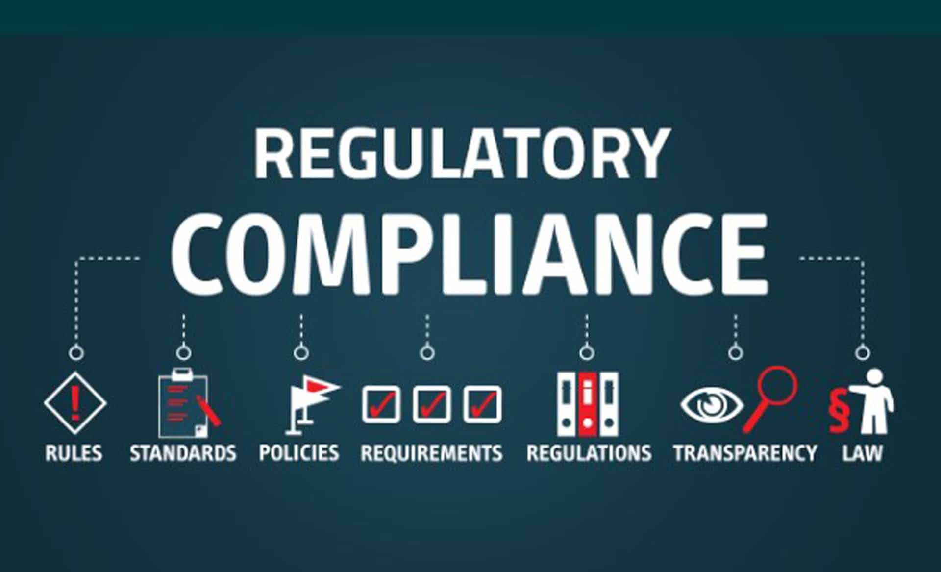
Privacy and Security in Blockchain and Smart Contracts: Regulatory Compliance
Regulatory compliance is a crucial aspect of privacy and security in blockchain and smart contracts, especially considering the evolving legal landscape and the need to adhere to various regulations and standards. Here are key considerations regarding regulatory compliance in blockchain and smart contracts:
Legal Frameworks: Understand and comply with applicable legal frameworks, regulations, and standards relevant to blockchain technology and smart contracts. These may include data protection laws (e.g., GDPR, CCPA), financial regulations (e.g., KYC/AML), securities laws, and industry-specific regulations.
KYC/AML Compliance: Implement Know Your Customer (KYC) and Anti-Money Laundering (AML) procedures as required by regulatory authorities. Verify the identities of users, perform due diligence checks, and maintain records of transactions to detect and prevent illicit activities.
Data Protection: Ensure compliance with data protection regulations and standards to safeguard user data and privacy. Implement data minimization practices, encryption techniques, and secure storage mechanisms for sensitive information stored on the blockchain.
Smart Contract Audits: Conduct regular audits and assessments of smart contracts to ensure compliance with legal requirements, industry standards, and best practices. Audit processes should include code review, vulnerability assessments, and checks for regulatory adherence.
Notes:
GÖKSU
By prioritizing regulatory compliance in blockchain and smart contract initiatives, organizations can mitigate legal risks, build trust with stakeholders, and foster a compliant and secure environment for blockchain-based transactions and operations. Collaborating with legal experts, compliance professionals, and regulatory bodies is essential for navigating regulatory challenges effectively.

Slide 21
Privacy and Security in Blockchain and Smart Contracts: Regulatory Compliance
Transparency and Accountability: Foster transparency and accountability in blockchain networks and smart contracts by providing clear and accessible information about contract terms, transaction history, and data processing practices. Enable auditability and traceability of transactions for regulatory purposes.
Regulatory Reporting: Maintain accurate records and documentation required for regulatory reporting, auditing, and compliance verification. Ensure that smart contracts and blockchain operations can generate necessary reports and data trails as per regulatory requirements.
Legal Compliance in Contract Terms: Review and validate contract terms, clauses, and conditions to ensure alignment with legal requirements and regulatory constraints. Incorporate dispute resolution mechanisms, compliance checks, and regulatory disclosures in smart contract logic.
Compliance Monitoring and Updates: Establish processes for ongoing compliance monitoring, risk assessment, and updates to adapt to changes in regulations and legal requirements. Stay informed about regulatory developments and engage legal experts or compliance officers as needed.
Cross-Border Considerations: Understand cross-border implications and regulatory differences when operating in multiple jurisdictions. Comply with international regulations and consider legal advice for navigating complex regulatory landscapes.
Notes:
GÖKSU
By prioritizing regulatory compliance in blockchain and smart contract initiatives, organizations can mitigate legal risks, build trust with stakeholders, and foster a compliant and secure environment for blockchain-based transactions and operations. Collaborating with legal experts, compliance professionals, and regulatory bodies is essential for navigating regulatory challenges effectively.

Slide 22

Privacy and Security in Blockchain and Smart Contracts: Best Practices
Data Encryption: Encrypt sensitive data stored on the blockchain or transmitted over the network to protect it from unauthorized access. Use strong encryption algorithms and key management practices to ensure data confidentiality.
Access Control: Implement access controls and permissions to restrict data access and smart contract execution to authorized users or entities. Use role-based access controls (RBAC) and multi-factor authentication (MFA) where applicable.
Secure Development Lifecycle (SDLC): Follow a secure development lifecycle for smart contracts and blockchain applications. This includes requirements analysis, threat modeling, secure coding practices, code reviews, testing, and deployment with security in mind.
Code Auditing: Conduct regular code audits and security assessments of smart contracts by experienced developers and security experts. Use automated tools and manual checks to identify and mitigate vulnerabilities, bugs, and logic flaws.
Immutable Audit Trails: Leverage the immutability of blockchain to create immutable audit trails of transactions and smart contract interactions. Maintain a transparent and tamper-proof record of all actions for auditability and accountability.
Notes:
FATİH
By adopting these best practices, organizations can enhance the privacy, security, and trustworthiness of blockchain-based systems and smart contracts, reducing the risk of data breaches, fraud, and cyberattacks. Ongoing monitoring, risk assessment, and continuous improvement are key to maintaining a secure blockchain ecosystem.

Slide 23
Privacy and Security in Blockchain and Smart Contracts: Best Practices
Secure External Integrations: Be cautious when integrating with external systems, APIs, or oracles. Validate input data, sanitize inputs, and implement secure communication protocols to prevent unauthorized or malicious interactions that can compromise security.
Penetration Testing: Conduct penetration testing and vulnerability assessments of blockchain networks and smart contracts to identify and remediate security weaknesses. Test for common vulnerabilities such as reentrancy attacks, integer overflows, and unauthorized access.
Regular Updates and Patching: Keep smart contracts, blockchain nodes, and supporting infrastructure up to date with the latest security patches and updates. Monitor security advisories and apply patches promptly to mitigate known vulnerabilities.
User Education and Awareness: Educate users, developers, and stakeholders about blockchain security best practices, privacy considerations, and potential risks. Promote awareness of phishing attacks, social engineering tactics, and secure handling of private keys.
Compliance with Legal and Regulatory Requirements: Ensure compliance with data protection laws, financial regulations, and industry standards relevant to blockchain and smart contracts. Incorporate regulatory requirements into contract terms, data handling practices, and audit procedures.
Notes:
FATİH
By adopting these best practices, organizations can enhance the privacy, security, and trustworthiness of blockchain-based systems and smart contracts, reducing the risk of data breaches, fraud, and cyberattacks. Ongoing monitoring, risk assessment, and continuous improvement are key to maintaining a secure blockchain ecosystem.

Slide 24
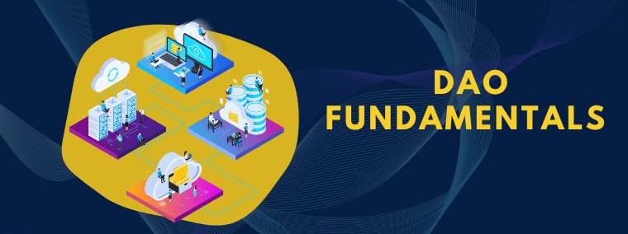
Real-world Applications of Smart Contracts in Decentralized Autonomous Organizations (DAOs) - DAO Fundamentals
Decentralized Autonomous Organizations (DAOs) are an innovative concept in blockchain technology that aim to create autonomous, decentralized entities governed by smart contracts and operated by a community of stakeholders. Here are the fundamentals of DAOs:
Decentralization: DAOs are decentralized entities that operate on blockchain networks, such as Ethereum. They do not have a central authority or single point of control, and decisions are made collectively by the DAO's stakeholders.
Autonomy: DAOs are designed to operate autonomously without human intervention for routine operations and decision-making. Smart contracts encode the rules and logic governing the DAO's activities, such as fund management, voting mechanisms, and governance processes.
Governance: DAO governance refers to the process by which decisions are made and actions are taken within the organization. Governance mechanisms in DAOs typically include voting mechanisms, proposal submission, decision-making rules, and dispute resolution procedures.
Notes:
GÖKSU
Overall, DAOs represent a paradigm shift in organizational structure and governance, leveraging blockchain technology to create transparent, autonomous, and community-driven entities. As the technology evolves and adoption grows, DAOs have the potential to disrupt traditional centralized organizations and empower decentralized decision-making and collaboration.

Slide 25
Real-world Applications of Smart Contracts in Decentralized Autonomous Organizations (DAOs) - DAO Fundamentals
Token-Based Participation: DAOs often use cryptographic tokens as a means of participation and governance. Token holders have voting rights, stake in the DAO's assets, and may receive rewards or dividends based on their contributions and participation in DAO activities.
Community Participation: DAOs are driven by community participation, where stakeholders actively engage in decision-making, proposal submissions, and voting on governance issues. DAOs promote inclusivity, transparency, and collaboration among community members.
Use Cases: DAOs have diverse use cases across various industries, including decentralized finance (DeFi), governance platforms, digital asset management, collective investment funds, content creation and curation platforms, and more. They enable new forms of decentralized collaboration and economic organization.
Challenges: Despite their potential benefits, DAOs face challenges such as scalability limitations, regulatory uncertainties, security vulnerabilities in smart contracts, governance scalability, and ensuring effective participation and decision-making by stakeholders.
Notes:
GÖKSU
Overall, DAOs represent a paradigm shift in organizational structure and governance, leveraging blockchain technology to create transparent, autonomous, and community-driven entities. As the technology evolves and adoption grows, DAOs have the potential to disrupt traditional centralized organizations and empower decentralized decision-making and collaboration.

Slide 26


Real-world Applications of Smart Contracts in Decentralized Autonomous Organizations (DAOs) - Role of Smart Contracts
The role of smart contracts in Decentralized Autonomous Organizations (DAOs) is fundamental to their functioning and governance. Smart contracts automate processes, enforce rules, and enable transparent and trustless interactions within DAOs. The real-world applications and key roles of smart contracts in DAOs:
Governance Mechanisms:
Voting Systems: Smart contracts facilitate democratic decision-making by implementing transparent and tamper-proof voting mechanisms. Token holders can cast votes on proposals, governance changes, fund allocations, and other DAO decisions.
Proposal Submission: Smart contracts enable members to submit proposals for consideration by the DAO community. Proposals can include budget requests, project funding, policy changes, and strategic initiatives.
Voting Rules: Smart contracts define voting rules, quorum requirements, voting periods, and decision thresholds. They automate the execution of decisions based on the outcome of votes, ensuring fairness and accuracy in governance processes.
Membership Management:
Token-Based Membership: Smart contracts manage membership in DAOs based on token ownership. Token holders are recognized as members with voting rights, participation privileges, and access to DAO resources.
Staking and Reputation: Smart contracts track members' contributions, staking activities, reputation scores, and governance participation. They may incentivize active participation and reward valuable contributions within the DAO ecosystem.
Notes:
GÖKSU

Slide 27


Real-world Applications of Smart Contracts in Decentralized Autonomous Organizations (DAOs) - Role of Smart Contracts
3. Asset Management:
Funds and Assets: Smart contracts manage DAO funds, assets, and reserves. They automate fund transfers, asset tokenization, asset management rules, and financial transactions within the DAO.
Escrow and Disbursement: Smart contracts can act as escrow agents for funds and assets, ensuring secure and transparent transactions. They automate disbursements, payments, royalties, and revenue sharing among DAO members.
Rules and Regulations:
Code of Conduct: Smart contracts enforce code of conduct rules, governance principles, and operational guidelines within DAOs. They define and execute rules related to membership eligibility, voting eligibility, dispute resolution, and compliance with DAO policies.
Compliance and Audits: Smart contracts facilitate compliance checks, audits, and transparency requirements. They maintain audit trails, record governance activities, and ensure regulatory compliance where applicable.
Notes:
GÖKSU

Slide 28


Real-world Applications of Smart Contracts in Decentralized Autonomous Organizations (DAOs) - Role of Smart Contracts
5. Automated Services:
Automated Services: Smart contracts can provide automated services and functionalities within DAOs, such as asset management, token swaps, decentralized exchanges, lending/borrowing protocols, prediction markets, and other DeFi services.
Integration with Oracles: Smart contracts integrate with oracles to access real-world data, external events, and market information. They use oracles to trigger actions, update contract states, and enable dynamic decision-making based on external inputs.
6. Dispute Resolution:
Arbitration and Dispute Resolution: Smart contracts support arbitration mechanisms, dispute resolution procedures, and governance arbitration panels within DAOs. They automate dispute handling, escrow release conditions, and arbitration decisions based on predefined rules and conditions.
Notes:
GÖKSU
Overall, smart contracts play a central role in DAOs by providing automated governance, membership management, asset management, regulatory compliance, and decentralized services. They enhance transparency, efficiency, and trust in DAO operations while empowering community-driven decision-making and collaboration.

Slide 29
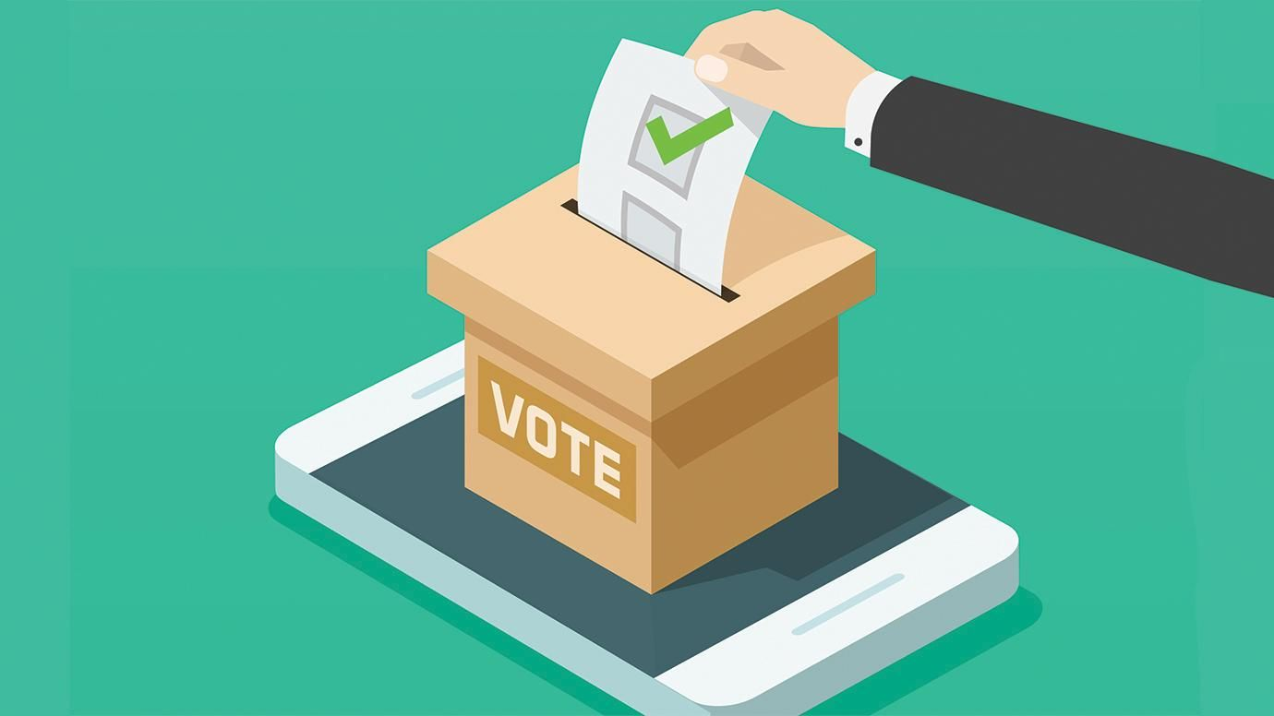

Real-world Applications of Smart Contracts in Decentralized Autonomous Organizations (DAOs) - Governance and Decision-Making
Smart contracts play a pivotal role in governance and decision-making within Decentralized Autonomous Organizations (DAOs). They automate processes, enforce rules, and enable transparent and democratic decision-making among DAO members. Here are real-world applications of smart contracts in governance and decision-making within DAOs:
Voting Mechanisms:
Proposal Voting: Smart contracts facilitate proposal submission and voting mechanisms within DAOs. Members can submit proposals for funding, policy changes, project initiatives, and other governance matters. Smart contracts manage the voting process, tally votes, and execute decisions based on predefined rules.
Quorum Requirements: Smart contracts enforce quorum requirements for valid votes, ensuring that a minimum percentage of eligible members participate in voting processes. Quorum rules can be customized based on DAO governance models.
Decision Thresholds: Smart contracts define decision thresholds for passing proposals. Thresholds can be majority votes, supermajority votes, or other consensus mechanisms determined by the DAO's governance rules.
Transparent Governance:
Auditability: Smart contracts maintain transparent and auditable records of governance activities, including proposal submissions, voting outcomes, decision execution, and fund allocations. The immutability of blockchain ensures tamper-proof audit trails.
Transparency: Smart contracts enable transparent governance by providing real-time access to governance processes, voting results, and decision-making procedures. Members can monitor governance activities and participate in discussions openly.
Notes:
GÖKSU
Overall, smart contracts empower DAOs with efficient, transparent, and inclusive governance and decision-making processes. They promote community-driven participation, accountability, and consensus while enhancing the agility and adaptability of DAO governance structures.

Slide 30
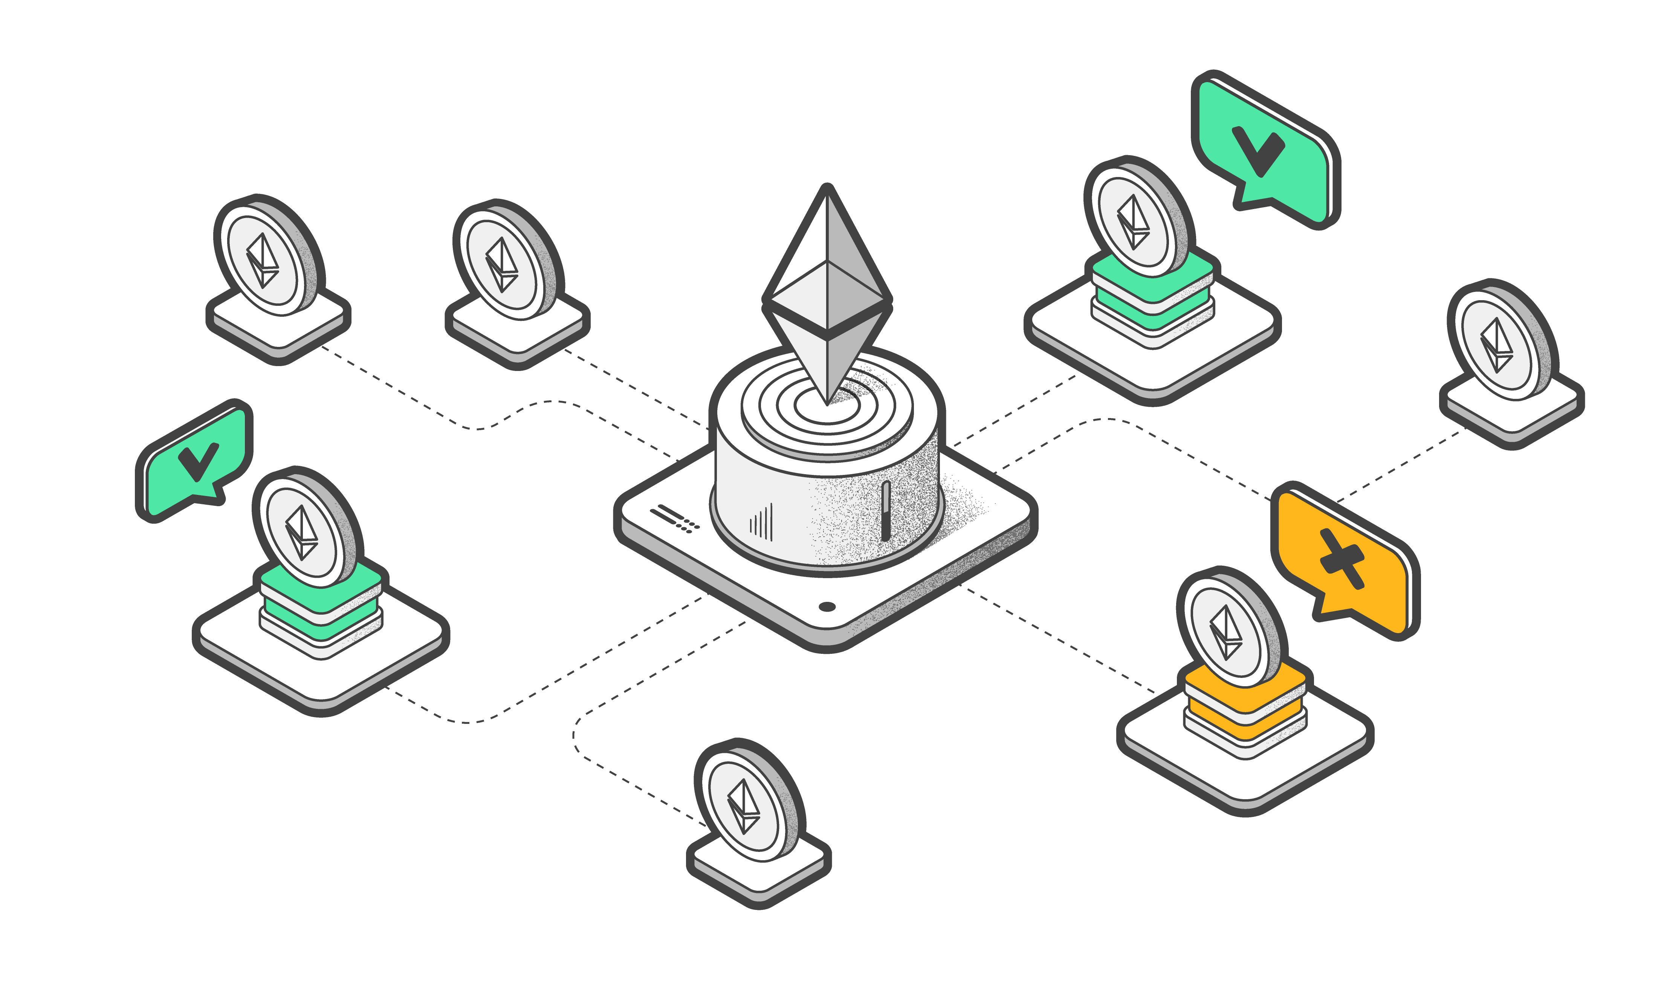

Real-world Applications of Smart Contracts in Decentralized Autonomous Organizations (DAOs) - Governance and Decision-Making
Token-Based Governance:
Token Voting: Smart contracts link governance rights to token ownership within DAOs. Token holders have voting power proportional to their token holdings, allowing for decentralized decision-making based on stakeholder interests.
Token Staking: Smart contracts manage token staking mechanisms where members stake tokens as a form of commitment or endorsement for proposals. Staking can influence voting weight, reputation scores, and participation incentives.
Dynamic Governance Rules:
Parameter Updates: Smart contracts enable dynamic governance rules by allowing parameter updates based on DAO consensus. Governance parameters such as voting periods, decision thresholds, quorum levels, and governance structures can be modified through governance proposals and votes.
Adaptive Governance: Smart contracts support adaptive governance models where governance rules evolve based on community feedback, market conditions, and DAO performance metrics. Adaptive governance mechanisms enable DAOs to remain agile and responsive to changing needs.
Notes:
GÖKSU
Overall, smart contracts empower DAOs with efficient, transparent, and inclusive governance and decision-making processes. They promote community-driven participation, accountability, and consensus while enhancing the agility and adaptability of DAO governance structures.

Slide 31

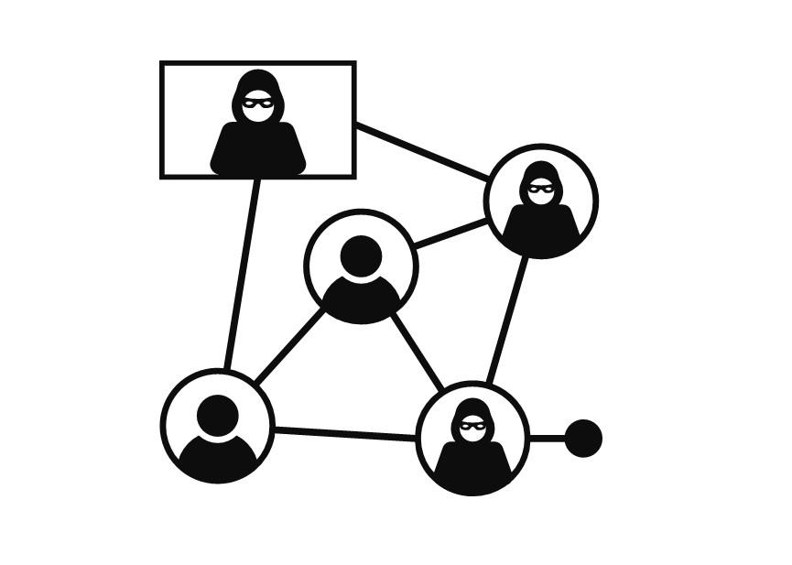
Real-world Applications of Smart Contracts in Decentralized Autonomous Organizations (DAOs) - Governance and Decision-Making
Incentive Mechanisms:
Governance Tokens: Smart contracts issue governance tokens that represent voting rights and participation incentives within DAOs. Governance tokens may also provide access to exclusive benefits, rewards, or revenue sharing opportunities based on governance contributions.
Reward Distribution: Smart contracts automate reward distribution mechanisms for governance participants, rewarding active contributors, voters, and proposal initiators based on predefined reward algorithms and criteria.
Decentralized Decision-Making:
Collective Decision-Making: Smart contracts enable collective decision-making among DAO members, fostering decentralized governance structures. Members can propose, discuss, vote, and execute decisions autonomously without relying on centralized authorities.
Sybil Resistance: Smart contracts implement Sybil resistance mechanisms to prevent manipulation and vote buying by ensuring that each member's voting power is tied to genuine stake and contributions within the DAO.
Notes:
GÖKSU
Overall, smart contracts empower DAOs with efficient, transparent, and inclusive governance and decision-making processes. They promote community-driven participation, accountability, and consensus while enhancing the agility and adaptability of DAO governance structures.
Sybil saldırısı, bir ağı birden fazla sahte kimlik oluşturarak kontrol etme girişimidir

Slide 32
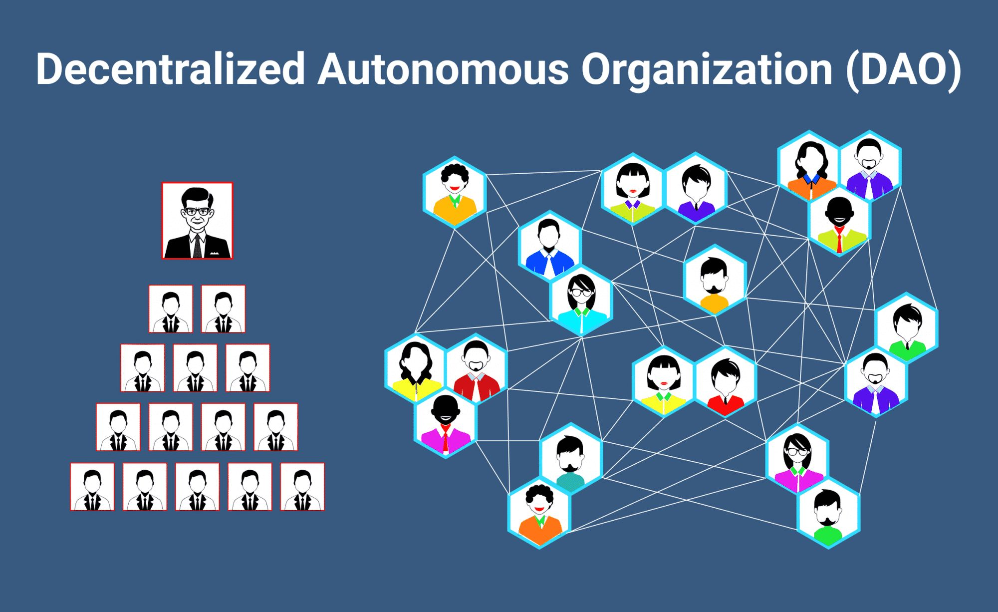
Real-world Applications of Smart Contracts in Decentralized Autonomous Organizations (DAOs) - DAO Case Studies
Some real-world case studies showcasing the applications of smart contracts in Decentralized Autonomous Organizations (DAOs):
The DAO (Decentralized Autonomous Organization):
Overview: The DAO was one of the earliest and most prominent DAOs launched on the Ethereum blockchain in 2016. It aimed to create a decentralized venture capital fund where token holders could vote on investment proposals and receive returns based on successful investments.
Smart Contract Features: The DAO's smart contracts facilitated proposal submission, voting, fund allocation, and dividend distribution. Members could propose investment opportunities, vote on proposals, and manage the DAO's investment portfolio autonomously.
Challenges: The DAO faced a significant security vulnerability in its smart contracts, leading to a major exploit and loss of funds. This incident highlighted the importance of rigorous smart contract audits, security best practices, and risk mitigation strategies in DAOs.
Notes:
FATİH
These case studies illustrate the diverse applications of smart contracts in DAOs, ranging from investment management and grant funding to decentralized governance and DeFi innovation. They highlight the potential of DAOs to transform traditional organizational models and empower decentralized decision-making and collaboration.

Slide 33
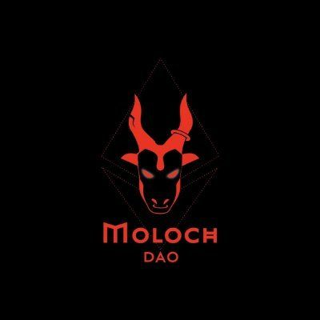
Real-world Applications of Smart Contracts in Decentralized Autonomous Organizations (DAOs) - DAO Case Studies
2. MolochDAO:
Overview: MolochDAO is a decentralized grant-making DAO focused on funding Ethereum ecosystem projects. It allows members to pool funds, vote on grant proposals, and allocate grants to support development initiatives.
Smart Contract Features: MolochDAO's smart contracts manage membership, proposal submission, voting mechanisms, and fund disbursement. Members stake tokens to join the DAO and participate in governance decisions.
Successes: MolochDAO has successfully funded various Ethereum projects, including infrastructure development, research grants, and community initiatives. It demonstrates the effectiveness of DAOs in supporting decentralized ecosystems and fostering innovation.
Notes:
FATİH
These case studies illustrate the diverse applications of smart contracts in DAOs, ranging from investment management and grant funding to decentralized governance and DeFi innovation. They highlight the potential of DAOs to transform traditional organizational models and empower decentralized decision-making and collaboration.

Slide 34
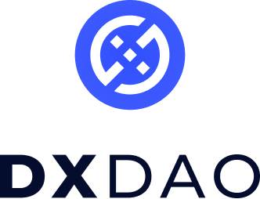
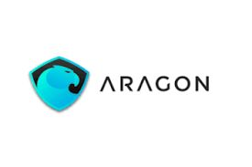
Real-world Applications of Smart Contracts in Decentralized Autonomous Organizations (DAOs) - DAO Case Studies
DXdao:
Overview: DXdao is a decentralized organization focused on building and governing decentralized finance (DeFi) products and services. It operates on the Ethereum blockchain and aims to create open, permissionless financial infrastructure.
Smart Contract Features: DXdao's smart contracts manage token-based governance, decision-making processes, product development, and revenue sharing. Members participate in governance by holding DXD tokens and voting on proposals.
Achievements: DXdao has launched various DeFi products, including decentralized exchanges (DEXs), liquidity pools, and governance tools. It demonstrates how DAOs can drive innovation, collaboration, and value creation in the DeFi space.
AragonDAO:
Overview: AragonDAO is a platform for creating and managing decentralized organizations, including DAOs. It provides tools and templates for launching DAOs, managing governance processes, and executing smart contract-based operations.
Smart Contract Features: AragonDAO's smart contracts enable the creation of customizable DAOs with features such as voting, membership management, token issuance, and decentralized governance structures.
Use Cases: AragonDAO has been used to launch DAOs across various industries, including governance platforms, investment funds, content creation communities, and decentralized applications (dApps). It empowers organizations to operate autonomously and transparently on the blockchain.
Notes:
FATİH
These case studies illustrate the diverse applications of smart contracts in DAOs, ranging from investment management and grant funding to decentralized governance and DeFi innovation. They highlight the potential of DAOs to transform traditional organizational models and empower decentralized decision-making and collaboration.

Slide 35
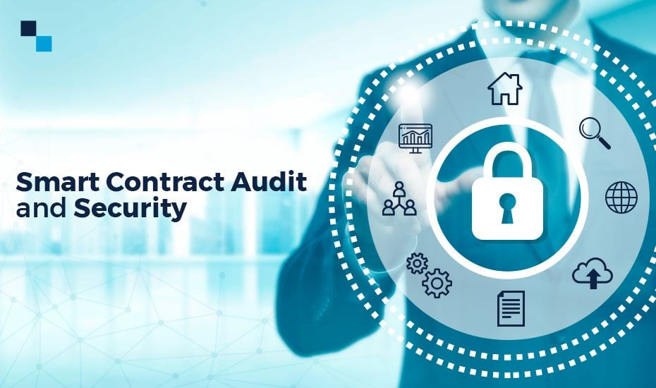

Real-world Applications of Smart Contracts in Decentralized Autonomous Organizations (DAOs) DAO Challenges and Security
Some real-world challenges and security considerations associated with smart contracts in Decentralized Autonomous Organizations (DAOs):
Smart Contract Security Audits:
Challenge: Smart contracts are susceptible to vulnerabilities such as coding errors, logic flaws, and security weaknesses. Ensuring the security of smart contracts requires thorough code audits, vulnerability assessments, and security testing.
Security Measures: DAOs must conduct regular security audits by experienced professionals to identify and mitigate vulnerabilities. Automated tools, manual code reviews, and best practices like formal verification can enhance smart contract security.
Tokenomics and Economic Models:
Challenge: Designing robust tokenomics and economic models for DAOs is challenging. Balancing token distribution, voting power, staking mechanisms, and incentive structures while preventing token manipulation and Sybil attacks requires careful planning.
Security Measures: DAOs should employ tokenomics experts and economists to design sustainable economic models. Implementing governance mechanisms, token locks, vesting schedules, and anti-manipulation measures can enhance token security and value stability.
Notes:
FATİH
Addressing these challenges and implementing robust security measures is essential for ensuring the trust, resilience, and success of Decentralized Autonomous Organizations (DAOs) leveraging smart contracts. Collaboration between technical experts, economists, legal advisors, and the DAO community is key to overcoming these challenges and advancing the adoption of DAOs in diverse industries.

Slide 36


Real-world Applications of Smart Contracts in Decentralized Autonomous Organizations (DAOs) DAO Challenges and Security
3.Governance Scalability:
Challenge: Scalability is a challenge for DAO governance, especially as membership grows and governance decisions become more complex. Ensuring efficient decision-making, consensus formation, and dispute resolution while maintaining decentralization is a key challenge.
Security Measures: DAOs can implement scalable governance structures, voting delegation mechanisms, quadratic voting, and reputation-based systems to enhance governance scalability. Smart contract upgrades and modular governance frameworks can also improve flexibility and adaptability.
Sybil Resistance and Identity Verification:
Challenge: Preventing Sybil attacks and ensuring identity verification in DAOs is challenging. Verifying the authenticity of members, preventing fake identities, and mitigating collusion risks are critical security concerns.
Security Measures: DAOs can implement identity verification procedures, KYC/AML checks, and reputation systems to enhance Sybil resistance and trust within the community. Integrating decentralized identity (DID) solutions and oracle-based identity verification can strengthen identity management.
Notes:
FATİH
Addressing these challenges and implementing robust security measures is essential for ensuring the trust, resilience, and success of Decentralized Autonomous Organizations (DAOs) leveraging smart contracts. Collaboration between technical experts, economists, legal advisors, and the DAO community is key to overcoming these challenges and advancing the adoption of DAOs in diverse industries.

Slide 37


Real-world Applications of Smart Contracts in Decentralized Autonomous Organizations (DAOs) DAO Challenges and Security
5. Smart Contract Upgradability and Governance Risk:
Challenge: Balancing smart contract upgradability with security and governance risks is challenging. Upgrading smart contracts can introduce new vulnerabilities, disrupt governance processes, and impact token holders' trust.
Security Measures: DAOs should adopt transparent and secure smart contract upgradability mechanisms, such as upgradeability proxies, timelock delays, and multisig governance for upgrade approvals. Implementing emergency protocols, rollback options, and community governance feedback can mitigate risks associated with upgrades.
6. Regulatory Compliance and Legal Challenges:
Challenge: Navigating regulatory compliance, legal frameworks, and jurisdictional challenges is a complex aspect of DAO operations. Ensuring compliance with data protection laws, financial regulations, and governance standards while operating globally requires legal expertise.
Security Measures: DAOs should collaborate with legal experts to navigate regulatory challenges, draft compliant governance structures, and address legal risks. Implementing privacy-preserving technologies, audit trails, and regulatory reporting mechanisms can enhance compliance and risk management.
Notes:
FATİH
Addressing these challenges and implementing robust security measures is essential for ensuring the trust, resilience, and success of Decentralized Autonomous Organizations (DAOs) leveraging smart contracts. Collaboration between technical experts, economists, legal advisors, and the DAO community is key to overcoming these challenges and advancing the adoption of DAOs in diverse industries.

Slide 38

AI-Powered Smart Contracts - AI in Smart Contracts
AI (Artificial Intelligence) integration in smart contracts is a cutting-edge development that holds significant potential for enhancing automation, decision-making, and intelligence within decentralized systems. Here are some key aspects and applications of AI in smart contracts:
Intelligent Automation:
Automated Execution: AI algorithms can automate the execution of smart contract actions based on predefined conditions, events, or triggers. For example, AI can automate payment releases, contract renewals, or asset transfers based on real-time data and insights.
Dynamic Contract Logic: AI-powered smart contracts can adapt their logic and behavior dynamically based on evolving conditions, market trends, and user preferences. They can optimize contract terms, pricing models, and service levels in response to changing environments.
Predictive Analytics:
Data Analysis: AI algorithms can analyze large datasets and historical transaction records to derive insights, patterns, and predictive models. This data-driven approach enables smart contracts to make informed decisions, forecast outcomes, and mitigate risks.
Risk Management: AI-powered smart contracts can assess and manage risks proactively by analyzing market trends, volatility indicators, and risk factors. They can trigger risk mitigation actions, hedging strategies, or contract adjustments based on predictive analytics.
Personalized Contracts:
Customized Terms: AI can personalize smart contract terms, conditions, and offerings based on individual user profiles, preferences, and behavior patterns. This personalization enhances user experience, engagement, and satisfaction within decentralized platforms.
Dynamic Pricing: AI-powered smart contracts can implement dynamic pricing models, discounts, incentives, and promotions tailored to each user's needs and value contribution. This flexibility promotes fairness, efficiency, and value creation.
Notes:
GÖKSU

Slide 39
AI-Powered Smart Contracts - AI in Smart Contracts
Smart Contract Oracles:
AI-Driven Oracles: AI algorithms can serve as smart contract oracles by providing real-time data feeds, market insights, and external event notifications. AI oracles enhance the accuracy, reliability, and relevance of external inputs used in smart contract execution.
Data Verification: AI oracles can verify data authenticity, integrity, and accuracy before feeding it into smart contracts. They can detect anomalies, fraud attempts, and data quality issues, ensuring the reliability of contract inputs.
Natural Language Processing (NLP):
Smart Contract Creation: NLP algorithms can enable natural language smart contract creation, allowing users to define contract terms, conditions, and rules using human-readable language. This simplifies contract creation and enhances accessibility for non-technical users.
Contract Interpretation: AI-powered NLP can interpret and analyze contract text, clauses, and legal language to extract meaning, intent, and obligations. This improves contract comprehension, reduces ambiguity, and facilitates dispute resolution.
Smart Contract Governance:
AI Governance Models: AI can assist in governance mechanisms within smart contracts, such as voting systems, consensus algorithms, and decision-making processes. AI-driven governance models can enhance transparency, efficiency, and fairness in DAOs and decentralized platforms.
Compliance Monitoring: AI-powered smart contracts can monitor regulatory compliance, audit trails, and legal requirements in real time. They can detect non-compliant actions, trigger alerts, and enforce regulatory rules within decentralized systems.
Notes:
GÖKSU
Overall, AI integration in smart contracts enables intelligent automation, predictive analytics, personalized experiences, reliable oracles, NLP capabilities, and enhanced governance. It empowers decentralized platforms, DAOs, and blockchain ecosystems with advanced intelligence, efficiency, and innovation capabilities. However, AI-powered smart contracts also raise considerations regarding data privacy, algorithm bias, security risks, and regulatory compliance, which require careful planning and governance.

Slide 40
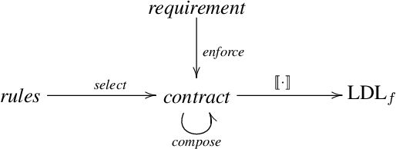
AI-Powered Smart Contracts - Dynamic and Adaptive Contracts
Dynamic and adaptive contracts refer to smart contract models that can adjust their terms, conditions, or execution logic based on changing circumstances, input data, or predefined triggers. These contracts go beyond static agreements by incorporating flexibility, responsiveness, and adaptability into their design. Here's a closer look at dynamic and adaptive contracts:
Dynamic Contract Logic:
Condition-Based Execution: Dynamic contracts can execute different actions or clauses based on specific conditions or events. For example, a contract may release funds upon delivery confirmation or adjust pricing based on market fluctuations.
Parameterized Terms: Dynamic contracts allow parameters such as payment terms, deadlines, quantities, or service levels to be adjustable during the contract's lifecycle. Parties can modify contract parameters without renegotiating the entire agreement.
Escalation Protocols: Contracts can include escalation protocols that trigger specific actions or interventions in response to predefined escalation criteria, such as dispute resolution processes or contract renegotiations.
Notes:
GÖKSU

Slide 41

AI-Powered Smart Contracts - Dynamic and Adaptive Contracts
2. Adaptive Contract Models:
Learning Algorithms: Adaptive contracts may utilize machine learning algorithms to analyze data, predict future trends, and optimize contract performance. These contracts can learn from past interactions, user feedback, or market dynamics to improve decision-making.
Feedback Mechanisms: Contracts can incorporate feedback mechanisms that gather input from stakeholders, users, or external sources to adapt contract terms, policies, or functionalities. Feedback loops enable continuous improvement and alignment with stakeholders' evolving needs.
Real-Time Adjustments: Adaptive contracts can make real-time adjustments to contract parameters, pricing structures, rewards, or penalties based on changing conditions, performance metrics, or user behavior. This real-time adaptability enhances contract efficiency and responsiveness.
Notes:
GÖKSU

Slide 42


AI-Powered Smart Contracts - Dynamic and Adaptive Contracts
Use Cases and Benefits:
Supply Chain Management: Dynamic contracts in supply chains can adjust delivery schedules, pricing terms, or inventory levels based on demand fluctuations, production delays, or market conditions.
Service Level Agreements (SLAs): Adaptive contracts in SLAs can dynamically adjust service levels, response times, or performance metrics based on service quality feedback, customer satisfaction scores, or system performance data.
Insurance Contracts: Dynamic contracts in insurance can adapt coverage terms, premiums, or claim processing workflows based on risk assessments, claim history, or external risk factors (e.g., weather events, market trends).
Financial Instruments: Adaptive contracts in financial instruments can optimize investment strategies, risk management approaches, or asset allocations based on market indicators, investor preferences, or portfolio performance metrics.
Challenges and Considerations:
Data Accuracy: Dynamic and adaptive contracts rely on accurate and reliable data inputs. Ensuring data integrity, quality, and authenticity is crucial to prevent erroneous contract adjustments or decisions.
Security and Compliance: Adaptive contracts must adhere to security protocols, privacy regulations, and compliance standards when adjusting contract terms, processing sensitive data, or executing automated actions.
Transparency and Accountability: Contracts should maintain transparency regarding adaptive mechanisms, decision-making processes, and contract adjustments to foster trust, accountability, and fairness among parties.
Notes:
GÖKSU
Dynamic and adaptive contracts represent a paradigm shift in contract management, enabling real-time responsiveness, personalized experiences, and optimized outcomes in diverse industries. However, they require robust data analytics, AI capabilities, governance frameworks, and security measures to unleash their full potential while mitigating risks.

Slide 43

AI-Powered Smart Contracts - Use Cases: Predictive Contract Execution
AI-powered smart contracts with predictive contract execution capabilities leverage machine learning algorithms to forecast future events, outcomes, or trends relevant to contract performance. Here are some use cases and benefits of predictive contract execution in AI-powered smart contracts:
Financial Contracts and Investments:
Use Case: Predictive contract execution can be applied in financial contracts, such as investment agreements, loans, or derivatives. AI algorithms analyze market data, economic indicators, and asset performance to predict investment trends, risks, and returns.
Benefits: Investors can make informed decisions based on predictive analytics, optimize portfolio allocations, hedge risks, and enhance investment strategies. Contracts can automatically adjust terms, trigger actions (e.g., automatic asset sales or purchases), or update performance benchmarks based on predictive insights.
Supply Chain Contracts:
Use Case: Predictive contract execution can optimize supply chain contracts by forecasting demand, inventory levels, production schedules, and logistics requirements. AI algorithms analyze historical data, market demand patterns, and supply chain disruptions to predict future needs and optimize contract terms.
Benefits: Suppliers can proactively manage inventory, production capacity, and distribution logistics based on predictive insights. Contracts can automatically adjust delivery schedules, pricing models, or production quotas to align with predicted demand fluctuations and market trends.
Insurance Contracts:
Use Case: Predictive contract execution can improve insurance contracts by assessing risk profiles, claim probabilities, and fraud detection. AI algorithms analyze customer data, claim history, industry trends, and risk factors to predict insurance claims, assess coverage adequacy, and prevent fraudulent activities.
Benefits: Insurers can optimize underwriting processes, pricing models, and claim settlements based on predictive analytics. Contracts can automatically adjust premiums, coverage limits, or claim processing workflows in response to predicted risk levels and claim probabilities.
Notes:
FATİH

Slide 44
AI-Powered Smart Contracts - Use Cases: Predictive Contract Execution
Service Level Agreements (SLAs):
Use Case: Predictive contract execution can enhance SLAs by forecasting service performance, downtime risks, and customer satisfaction levels. AI algorithms analyze historical service data, user feedback, system metrics, and performance indicators to predict service levels, identify potential issues, and proactively address service disruptions.
Benefits: Service providers can optimize service delivery, response times, and resource allocations based on predictive insights. Contracts can automatically trigger service improvements, escalations, or compensations to meet predicted service levels and exceed customer expectations.
Real Estate Contracts:
Use Case: Predictive contract execution can benefit real estate contracts by forecasting property values, market trends, rental yields, and investment opportunities. AI algorithms analyze real estate data, market dynamics, economic indicators, and demographic trends to predict property prices, rental demand, and investment returns.
Benefits: Real estate investors, developers, and property managers can make data-driven decisions, optimize property portfolios, and mitigate investment risks. Contracts can automatically adjust lease terms, rental prices, or property management strategies based on predicted market conditions and investment performance.
Notes:
FATİH
Overall, predictive contract execution in AI-powered smart contracts enables data-driven decision-making, risk mitigation, and contract optimization across various industries. By leveraging predictive analytics, machine learning, and real-time data insights, these contracts can adapt to changing environments, enhance contract performance, and deliver value to stakeholders. However, implementing predictive contract execution requires robust data management, AI capabilities, and governance frameworks to ensure accuracy, transparency, and compliance with legal and regulatory requirements.

Slide 45

AI-Powered Smart Contracts - Benefits
Automation and Efficiency: AI-powered smart contracts automate contract execution, decision-making, and data analysis, leading to increased efficiency, reduced manual errors, and streamlined processes.
Predictive Insights: AI algorithms provide predictive insights and analytics, enabling informed decision-making, risk mitigation, and optimized contract terms based on real-time data and market trends.
Personalization and Adaptability: AI enables personalized contract terms, dynamic pricing models, and adaptive functionalities tailored to individual users' preferences, behavior patterns, and performance metrics.
Enhanced Security: AI-powered smart contracts enhance security through advanced encryption, anomaly detection, fraud prevention, and real-time monitoring of transactional activities, reducing cybersecurity risks.
Real-Time Adjustments: AI enables real-time adjustments to contract parameters, pricing structures, or service levels based on changing conditions, user feedback, or predictive analytics, improving contract responsiveness and value delivery.
Data-driven Decision-making: AI empowers data-driven decision-making by analyzing large datasets, deriving actionable insights, and optimizing contract performance, leading to improved outcomes, cost savings, and competitive advantages.
Notes:
FATİH

Slide 46

AI-Powered Smart Contracts - Limitations
Complexity and Technical Expertise: Implementing AI-powered smart contracts requires technical expertise in AI, machine learning, blockchain development, and data analytics, limiting accessibility for non-technical users and organizations.
Data Privacy and Bias: AI-powered smart contracts raise concerns about data privacy, security, and algorithm bias, requiring robust privacy measures, ethical AI practices, and regulatory compliance to address these challenges.
Cost and Resource Intensiveness: Developing and maintaining AI-powered smart contracts can be resource-intensive, requiring investments in AI infrastructure, data management, training datasets, and ongoing maintenance, which may pose financial challenges for some organizations.
Regulatory and Legal Compliance: AI-powered smart contracts must comply with legal and regulatory frameworks governing data protection, consumer rights, contract law, and financial regulations, necessitating legal expertise and compliance measures.
Scalability and Interoperability: Scaling AI-powered smart contracts to handle large transaction volumes, diverse use cases, and interoperability with legacy systems or external platforms may pose technical challenges and require scalable solutions.
Algorithmic Risks and Transparency: AI algorithms in smart contracts may introduce algorithmic risks, such as model drift, bias, or unintended consequences, highlighting the importance of algorithm transparency, auditability, and risk management practices.
Notes:
FATİH
addressing these limitations requires a holistic approach, involving collaboration between AI experts, blockchain developers, legal advisors, regulators, and stakeholders to ensure responsible AI deployment, mitigate risks, and maximize the benefits of AI-powered smart contracts.

Slide 47

AI-Powered Smart Contracts - Research Avenues
Research avenues in AI-powered smart contracts focus on advancing technology, addressing challenges, and exploring new opportunities for innovation and application. Some key research areas include:
Advanced Machine Learning Algorithms:
Research in developing and optimizing machine learning algorithms specifically tailored for smart contract applications. This includes reinforcement learning, deep learning, and ensemble learning techniques for improved predictive analytics, anomaly detection, and decision-making within smart contracts.
Explainable AI (XAI) in Smart Contracts:
Exploring methods and frameworks for creating explainable AI models within smart contracts. XAI techniques help enhance transparency, interpretability, and trustworthiness by providing explanations for AI-driven decisions and behaviors.
Privacy-Preserving AI in Smart Contracts:
Researching privacy-preserving AI techniques such as federated learning, differential privacy, and secure multiparty computation (MPC) for ensuring data privacy, confidentiality, and security in AI-powered smart contracts, particularly in sensitive or regulated domains.
AI Governance and Ethical Considerations:
Investigating governance frameworks, ethical guidelines, and regulatory compliance mechanisms for AI-powered smart contracts. This includes addressing algorithmic bias, fairness, accountability, and transparency issues, as well as ensuring adherence to legal and ethical standards.
Scalability and Performance Optimization:
Researching techniques for improving the scalability, performance, and efficiency of AI-powered smart contracts. This includes optimizing resource utilization, reducing computational overhead, and enhancing throughput in decentralized AI applications.
Notes:
FATİH

Slide 48
AI-Powered Smart Contracts - Research Avenues
Interoperability and Standardization:
Exploring interoperability standards, protocols, and frameworks for integrating AI-powered smart contracts with existing systems, external data sources, and blockchain networks. This includes developing open standards for data exchange, API integration, and cross-chain communication.
Secure Oracles and Data Feeds:
Researching secure oracle designs, data feed mechanisms, and trusted execution environments (TEEs) for reliable and tamper-resistant data inputs in AI-powered smart contracts. This includes exploring cryptographic protocols, zero-knowledge proofs, and verifiable computation techniques.
AI-Driven Contract Templates and Libraries:
Developing AI-driven contract templates, libraries, and reusable components for common use cases, such as financial instruments, supply chain agreements, insurance policies, and service level agreements (SLAs). This streamlines contract development, accelerates adoption, and promotes best practices.
Decentralized AI Marketplaces:
Investigating decentralized AI marketplaces, platforms, and ecosystems for exchanging AI models, algorithms, and services within smart contracts. This includes exploring tokenomics, incentivization mechanisms, and governance models for AI marketplace participants.
AI-Powered Governance and Decision-Making:
Researching AI-driven governance models, decision-making processes, and consensus mechanisms within decentralized organizations and autonomous systems. This includes exploring AI-driven voting systems, governance tokens, and stakeholder participation in smart contract governance.
Notes:
FATİH
These research avenues aim to drive innovation, address challenges, and unlock the full potential of AI-powered smart contracts in diverse domains such as finance, healthcare, supply chain management, governance, and beyond. Collaboration between academia, industry, policymakers, and blockchain communities is essential for advancing research in these areas and shaping the future of decentralized AI applications.

Slide 49
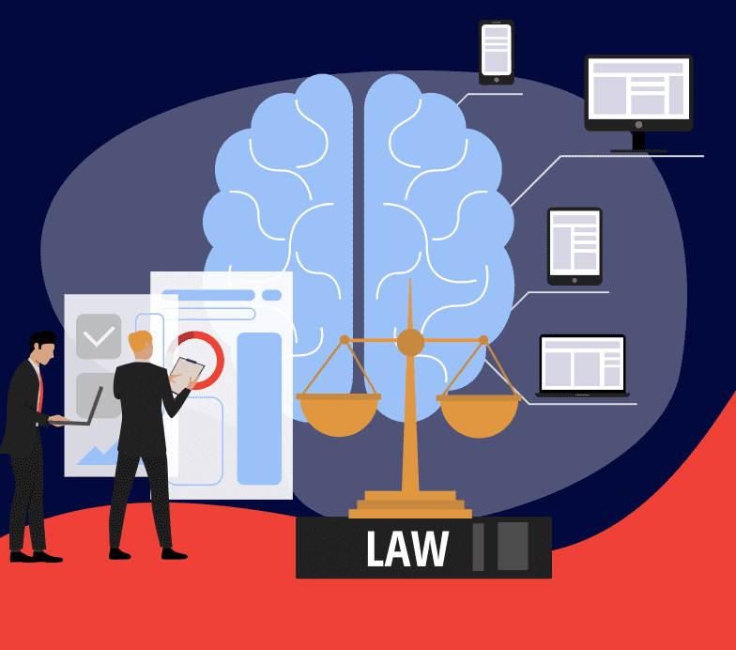
Smart Contracts in Legal Processes- Smart Contracts in Legal Context
Smart contracts in a legal context refer to the use of blockchain-based, self-executing contracts that automate and enforce contractual agreements without the need for intermediaries. Here are some key aspects and considerations regarding smart contracts in a legal context:
Definition and Characteristics: Smart contracts are digital agreements coded on blockchain platforms that automatically execute and enforce predefined terms and conditions.
They operate based on predefined rules and conditions, triggering actions when specified criteria are met, without requiring manual intervention.
Enforceability and Legitimacy: Smart contracts are recognized as legally binding agreements in many jurisdictions, provided they meet the criteria of offer, acceptance, consideration, and intention to create legal relations.
Legitimacy and enforceability depend on factors such as clarity of terms, consent of parties, compliance with legal requirements, and jurisdictional regulations.
Contract Formation and Execution: Smart contracts facilitate contract formation by automating the process of agreement, verification, and execution, reducing the need for traditional paper-based contracts and manual processes.
Notes:
GÖKSU

Slide 50
Smart Contracts in Legal Processes- Smart Contracts in Legal Context
Automated Performance and Payments: Smart contracts automate performance by executing contractual obligations, such as delivering goods, providing services, or making payments, based on predefined triggers or conditions.
They enable real-time tracking, verification, and validation of performance milestones, ensuring accurate and timely payments or penalties.
Dispute Resolution and Governance: Smart contracts can include dispute resolution mechanisms, such as arbitration clauses or multi-signature authorization, to resolve conflicts or disagreements among parties.
They support decentralized governance models, where stakeholders collectively participate in decision-making, voting, and consensus mechanisms embedded in smart contracts.
Legal Challenges and Solutions: Legal challenges include ensuring compliance with existing laws, regulations, and contractual standards, addressing privacy concerns, and resolving jurisdictional conflicts in cross-border transactions.
Solutions involve developing standardized legal frameworks, regulatory guidelines, and best practices for smart contract design, implementation, and enforcement.
Future Trends and Adoption: The adoption of smart contracts in legal contexts is increasing across industries such as finance, real estate, supply chain, insurance, and intellectual property.
Notes:
GÖKSU
Smart contracts in a legal context offer numerous benefits, including efficiency, transparency, automation, and reduced transaction costs. However, they also require careful consideration of legal implications, risk management strategies, and collaborative efforts between legal professionals, technologists, and regulatory authorities to realize their full potential and ensure legal compliance.

Slide 51



Smart Contracts in Legal Processes- Examples: Contract Execution, Escrow
Smart contracts in legal processes offer innovative solutions for various scenarios, including contract execution and escrow services. Here are examples of how smart contracts are used in these contexts:
Contract Execution:
Smart contracts streamline and automate the execution of contractual agreements. For example:
Real Estate Transactions: In real estate, smart contracts can facilitate property sales by automatically executing the transfer of ownership rights once payment conditions are met. The contract can verify payment from the buyer and transfer property ownership to the buyer upon confirmation, eliminating the need for intermediaries like escrow agents or title companies.
Freelance Services: Smart contracts can be used in freelance contracts to automate payment release based on predefined milestones or deliverables. When a freelancer completes a task or project, the smart contract triggers payment to the freelancer's wallet, ensuring prompt and transparent payment processing without relying on manual invoicing or payment procedures.
Supply Chain Agreements: Smart contracts in supply chain management can automate contract execution by triggering orders, payments, and logistics processes based on predefined conditions like delivery confirmation, quality inspections, or inventory levels. This reduces administrative overhead, enhances transparency, and improves efficiency in supply chain operations.
Notes:
GÖKSU

Slide 52



Smart Contracts in Legal Processes- Examples: Contract Execution, Escrow
2. Escrow Services:
Smart contracts are also utilized in escrow services to securely hold and release assets or funds based on predefined conditions. For example:
Real Estate Escrow: In real estate transactions, smart contracts act as escrow agents by holding funds from the buyer until all conditions, such as property inspections or legal clearances, are met. Once the conditions are satisfied, the smart contract releases the funds to the seller, ensuring a secure and transparent transaction process.
Online Marketplaces: Smart contracts can facilitate secure transactions in online marketplaces by acting as escrow services. When a buyer and seller agree on a transaction, the buyer's payment is held in escrow by the smart contract. The funds are released to the seller once the buyer confirms receipt of the goods or services, providing protection against fraud and ensuring fair dealings.
Crowdfunding Campaigns: Smart contracts in crowdfunding platforms can serve as escrow services by holding contributions from backers until the project reaches its funding goal. Once the goal is met, the smart contract releases the funds to the project owner, ensuring that funds are only disbursed when the project is fully funded as per the agreement.
Notes:
GÖKSU
These examples demonstrate how smart contracts revolutionize contract execution and escrow services by automating processes, enhancing security, reducing transaction costs, and increasing transparency and trust among parties involved in legal transactions.

Slide 53


Smart Contracts in Legal Processes- Benefits: Automation, Transparency
Smart contracts bring significant benefits to legal processes, particularly in terms of automation and transparency. Here are the key advantages:
Automation:
Efficiency: Smart contracts automate contract execution, payment processing, and compliance monitoring, reducing manual intervention and administrative overhead. This leads to faster transaction speeds and improved operational efficiency.
Accuracy: Automation reduces the risk of human error in contract execution and enforcement. Smart contracts execute predefined actions based on coded rules and conditions, ensuring accuracy and consistency in contract performance.
Cost Savings: By automating routine tasks and reducing the need for intermediaries such as escrow agents or legal advisors, smart contracts lower transaction costs, administrative expenses, and processing fees, resulting in cost savings for parties involved.
Transparency:
Immutable Record-keeping: Smart contracts maintain a transparent and immutable record of contract terms, actions, and transactions on the blockchain ledger. This provides a tamper-resistant audit trail that enhances transparency and accountability.
Real-time Updates: Parties can access real-time updates and visibility into contract status, performance metrics, and payment milestones through the transparent nature of smart contracts. This promotes trust and reduces disputes arising from information asymmetry.
Auditability: The transparency and traceability of smart contracts enable easy auditability by regulatory authorities, auditors, or stakeholders. Auditors can verify compliance with contractual terms, regulatory requirements, and industry standards more efficiently.
Dispute Resolution: Transparent and auditable smart contracts facilitate quicker and more accurate dispute resolution. Parties can refer to the transparent record of contract actions, timestamps, and verifiable data to resolve disputes based on objective evidence.
Notes:
FATİH
Overall, the automation capabilities of smart contracts streamline legal processes, improve efficiency, reduce costs, and enhance accuracy in contract execution and enforcement. The transparency provided by blockchain technology ensures trust, accountability, and auditability, fostering a more secure and reliable legal environment for conducting transactions and managing contractual agreements.

Slide 54



Smart Contracts in Legal Processes- Legal Challenges and Solutions
Legal challenges in the context of smart contracts include ensuring compliance with existing laws and regulations, addressing privacy concerns, resolving jurisdictional issues, and establishing legal frameworks for enforcement. Here are some key challenges and potential solutions:
Compliance with Laws and Regulations:
Challenge: Smart contracts must comply with legal requirements, contractual standards, consumer protection laws, financial regulations, and industry-specific regulations.
Solution: Collaborate with legal experts, regulators, and industry stakeholders to develop standardized legal frameworks, regulatory guidelines, and best practices for smart contract design, implementation, and enforcement. Conduct legal reviews and audits to ensure compliance with applicable laws and regulations in relevant jurisdictions.
Privacy and Data Protection:
Challenge: Smart contracts involve processing and storing sensitive data on the blockchain, raising privacy concerns and compliance with data protection laws such as GDPR.
Solution: Implement privacy-preserving techniques such as encryption, zero-knowledge proofs, and data anonymization to protect confidential information within smart contracts. Adhere to privacy-by-design principles and incorporate privacy-enhancing technologies to ensure data security and compliance with privacy regulations.
Jurisdictional and Cross-border Issues:
Challenge: Smart contracts operate globally on decentralized blockchain networks, leading to jurisdictional challenges, legal conflicts, and differences in regulatory requirements across jurisdictions.
Solution: Define jurisdictional clauses and choice of law provisions in smart contracts to specify applicable legal frameworks and dispute resolution mechanisms. Collaborate with legal advisors to navigate cross-border legal complexities, resolve jurisdictional conflicts, and ensure legal enforceability in international transactions.
Notes:
FATİH

Slide 55


Smart Contracts in Legal Processes- Legal Challenges and Solutions
Legal Validity and Enforceability:
Challenge: Ensuring the legal validity, enforceability, and admissibility of smart contracts in court proceedings, arbitration, or regulatory actions.
Solution: Draft smart contracts with clear and unambiguous terms, incorporate legal elements such as offer, acceptance, consideration, and intention to create legal relations. Use digital signatures, timestamping, and blockchain notarization services to establish the authenticity and integrity of smart contract records for legal purposes.
Smart Contract Audits and Governance:
Challenge: Conducting audits, due diligence, and governance oversight of smart contracts to verify compliance, identify vulnerabilities, and mitigate risks.
Solution: Implement smart contract audit procedures, code reviews, and security assessments by independent auditors, cybersecurity experts, and legal professionals. Establish governance structures, roles, and responsibilities for smart contract management, monitoring, and updates to ensure ongoing compliance and risk management.
Notes:
FATİH
By addressing these legal challenges through proactive measures, collaboration with legal experts, and adherence to regulatory requirements, organizations can enhance the legal validity, compliance, and trustworthiness of smart contracts in various legal contexts.

Slide 56

Smart Contracts in Legal Processes-Future of Legal Tech
The future of legal tech is marked by ongoing advancements in technology, automation, data analytics, and artificial intelligence (AI) that are transforming the legal industry. Here are some key trends and developments shaping the future of legal tech:
AI-Powered Legal Services:
AI technologies such as natural language processing (NLP), machine learning (ML), and predictive analytics are revolutionizing legal services.
AI-powered tools automate repetitive tasks, analyze large volumes of legal documents, predict case outcomes, and provide data-driven insights for legal decision-making.
Smart Contracts and Blockchain:
Smart contracts on blockchain platforms streamline contract execution, automate compliance, and enhance transparency and security in legal transactions.
Blockchain technology ensures tamper-resistant record-keeping, immutable contracts, and decentralized governance, reducing fraud risks and improving trust in legal processes.
Legal Automation and Workflow Management:
Legal tech solutions automate document drafting, contract management, case management, billing, and workflow optimization.
Automation tools improve efficiency, reduce manual errors, and enable legal professionals to focus on high-value tasks such as legal analysis, strategy, and client interaction.
Data Privacy and Compliance:
With the rise of data privacy regulations such as GDPR, CCPA, and HIPAA, legal tech focuses on compliance management, data protection, and privacy-enhancing technologies.
AI-driven compliance tools monitor regulatory changes, assess compliance risks, and implement data privacy measures to ensure legal and ethical data handling.
Notes:
FATİH

Slide 57
Smart Contracts in Legal Processes-Future of Legal Tech
Legal Analytics and Predictive Modeling:
Legal analytics platforms use data analytics, machine learning, and statistical modeling to extract insights from legal data, predict case outcomes, identify trends, and optimize legal strategies.
Predictive modeling tools assist in risk assessment, litigation forecasting, contract analysis, and regulatory compliance, improving decision-making and resource allocation.
Online Dispute Resolution (ODR) and Alternative Legal Services:
ODR platforms leverage technology for online mediation, arbitration, and dispute resolution, offering cost-effective and efficient alternatives to traditional legal processes.
Alternative legal services such as legal marketplaces, virtual law firms, and legal tech startups provide on-demand legal assistance, access to legal expertise, and flexible service models.
Ethical AI and LegalTech Governance:
Legal tech industry focuses on ethical AI development, responsible use of AI algorithms, and regulatory frameworks for AI-powered legal services.
LegalTech governance initiatives address ethical considerations, transparency, accountability, bias mitigation, and fair access to legal tech tools and services.
Collaboration and Interoperability:
Legal tech ecosystems emphasize collaboration, interoperability, and integration of diverse legal tech solutions, platforms, and APIs.
Open standards, data exchange protocols, and cross-platform compatibility enhance connectivity, data sharing, and seamless user experiences in legal tech ecosystems.
Notes:
FATİH
Overall, the future of legal tech is characterized by innovation, digital transformation, regulatory compliance, and a shift towards data-driven, AI-powered, and user-centric legal services and solutions. Collaboration between legal professionals, technologists, regulators, and stakeholders is crucial in shaping the future landscape of legal tech and driving positive outcomes for the legal industry and society as a whole.

Slide 58
Smart Contracts for Automated Legal Agreements- Legal Automation Challenges
Automated legal agreements using smart contracts offer numerous benefits, including efficiency, transparency, and accuracy. However, they also face several challenges related to legal automation. Here are some key challenges and considerations in implementing smart contracts for automated legal agreements:
Complexity of Legal Language:
Translating complex legal terms and conditions into code accurately.
Ensuring that smart contracts reflect legal requirements and comply with regulatory standards.
Interoperability and Integration:
Integrating smart contracts with existing legal systems, databases, and legacy software.
Ensuring seamless communication and compatibility with external systems.
Data Privacy and Security:
Protecting sensitive personal data processed and stored by smart contracts.
Ensuring compliance with data protection regulations and implementing privacy-enhancing technologies.
Legal Validity and Enforceability:
Establishing the legal validity, enforceability, and admissibility of smart contracts in legal proceedings.
Incorporating legal elements such as offer, acceptance, and consideration into smart contract terms.
Regulatory Compliance and Jurisdictional Issues:
Complying with laws, regulations, and industry-specific requirements across different jurisdictions.
Navigating regulatory complexities and ensuring legal compliance in diverse legal environments.
Auditability and Governance:
Implementing mechanisms for auditing smart contracts and monitoring contract performance.
Establishing governance frameworks, roles, and responsibilities for smart contract management and oversight.
Notes:
GÖKSU

Slide 59



Smart Contracts for Automated Legal Agreements - Use Cases: Contracts, Agreements
Automated Contract Execution: Smart contracts can automate the fulfillment of specific conditions. For example, they can ensure payments are made automatically when certain dates or conditions are met.
Payment Contracts: They can automate payments for specific transactions or services. These payments can occur automatically when conditions are met.
Tenant-Landlord Agreements: In tenant-landlord relationships, smart contracts can automate rent payments, track lease durations, and manage renewal or termination processes as needed.
Notes:
GÖKSU

Slide 60


Smart Contracts for Automated Legal Agreements - Use Cases: Contracts, Agreements
Supply Chain Contracts: In supply chain processes, smart contracts can manage and track deliveries, payment terms, and supplier performance.
Insurance Contracts: In the insurance sector, smart contracts can facilitate automatic payments in case of claims, track policy conditions, and verify requested documents.
License Agreements: For software or digital content licenses, smart contracts can manage usage rights, track license durations, and ensure compliance with licensing terms.
Notes:
GÖKSU

Slide 61
Smart Contracts for Automated Legal Agreements-Smart Contract Templates
// SPDX-License-Identifier: MIT
pragma solidity ^0.8.0;
contract SimpleSmartContractTemplate {
address public owner;
uint256 public data;
event DataUpdated(uint256 newValue);
constructor() {
owner = msg.sender;
data = 0;
}
function setData(uint256 _value) public {
require(msg.sender == owner, "Only the owner can set data");
data = _value;
emit DataUpdated(_value);
}
function getData() public view returns (uint256) {
return data;
}
}
Notes:
FATİH

Slide 62

Smart Contracts for Automated Legal Agreements- Legal and Ethical Considerations
Legal and ethical considerations play a crucial role in the development and implementation of smart contracts for automated legal agreements. Here are some key considerations:
Legal Validity: Smart contracts must comply with existing legal frameworks and be recognized as legally binding agreements. Ensuring that the terms and conditions of smart contracts are enforceable in courts is essential.
Regulatory Compliance: Smart contracts should adhere to relevant laws, regulations, and industry standards, such as data protection laws (e.g., GDPR), consumer protection laws, financial regulations (e.g., KYC/AML), and contract law principles.
Transparency: Smart contracts should be transparent and comprehensible to all parties involved. Clear and unambiguous terms, as well as accessible documentation, are necessary to ensure transparency and promote trust.
Notes:
FATİH

Slide 63
Smart Contracts for Automated Legal Agreements- Legal and Ethical Considerations
Security: Implementing robust security measures is critical to protect smart contracts from vulnerabilities, cyber attacks, and unauthorized access. Techniques like encryption, access controls, and audit trails can enhance security.
Data Privacy: Smart contracts should handle personal and sensitive data in compliance with data protection regulations. Privacy-enhancing technologies and data minimization practices can help protect individuals' privacy rights.
Dispute Resolution: Mechanisms for resolving disputes and addressing contract breaches should be defined within smart contracts. This may include arbitration clauses, escrow services, or decentralized dispute resolution platforms.
Ethical Implications: Consideration should be given to the ethical implications of smart contracts, such as fairness, equality, and inclusivity. Avoiding discriminatory practices and ensuring equitable outcomes are important ethical considerations.
Notes:
FATİH

Slide 64
Smart Contracts for Automated Legal Agreements- Legal and Ethical Considerations
Accessibility: Smart contracts should be accessible to individuals with diverse backgrounds, technical expertise, and disabilities. User-friendly interfaces and support for multiple languages can improve accessibility.
Auditability and Accountability: Smart contracts should facilitate auditability and accountability by providing transparent transaction records, immutable data storage, and mechanisms for tracking contract execution.
Governance: Establishing governance mechanisms for smart contract management, updates, and version control is essential. Clear roles, responsibilities, and decision-making processes should be defined.
Notes:
FATİH
Addressing these legal and ethical considerations requires collaboration between legal experts, technologists, regulators, and stakeholders. Conducting thorough legal reviews, risk assessments, and compliance checks is crucial to ensure the responsible and ethical use of smart contracts in automated legal agreements.

Slide 65
Smart Contracts for Automated Legal Agreements- Adoption in Legal Industry
Smart contracts have seen a gradual acceptance in the legal industry over the past decade. Initially met with skepticism in the early 2000s, these digital contracts gained traction in the mid-2010s as their efficiency and transparency benefits became more evident. By the late 2010s and early 2020s, legal professionals and organizations began embracing smart contracts as valuable tools for automating legal processes and ensuring secure transactions.
As we look ahead to the future, smart contracts are poised to become integral to legal operations, although challenges such as regulatory compliance and ethical considerations continue to shape their adoption.
Notes:
GÖKSU

Slide 66

Smart Contracts for Intellectual Property Licensing- Intellectual Property Licensing Challenges
Intellectual property (IP) licensing through smart contracts introduces several challenges that need to be addressed for successful implementation:
Interoperability: Ensuring compatibility and interoperability between different blockchain platforms and smart contract protocols can be a challenge. Standardization efforts are ongoing to address this issue.
Legal Compliance: Smart contracts must comply with existing IP laws and regulations, including copyright, patents, trademarks, and trade secrets. Ensuring legal validity and enforceability within the relevant jurisdictions is crucial.
Tokenization: Tokenizing IP assets for licensing purposes requires careful consideration of token design, ownership rights, transferability, and royalties distribution. Clear guidelines and standards for tokenized assets are needed.
Data Privacy: Handling sensitive IP information on the blockchain raises data privacy concerns. Implementing privacy-enhancing techniques such as zero-knowledge proofs or off-chain storage solutions may be necessary.
Notes:
GÖKSU

Slide 67
Smart Contracts for Intellectual Property Licensing- Intellectual Property Licensing Challenges
Smart Contract Security: Ensuring the security of smart contracts is paramount to prevent unauthorized access, manipulation, or exploitation of IP assets. Auditing, testing, and using secure coding practices are essential.
Royalties and Payments: Designing smart contracts to accurately calculate and distribute royalties and payments to IP owners, licensors, and stakeholders requires precise coding and validation mechanisms.
Dispute Resolution: Implementing mechanisms for dispute resolution and arbitration within smart contracts can be complex, especially for cross-border IP licensing agreements. Clear escalation paths and enforcement procedures are needed.
Regulatory Compliance: Adhering to regulatory requirements, such as export controls, antitrust laws, and licensing agreements, is critical for IP licensing through smart contracts. Compliance with international standards and industry best practices is essential.
Notes:
GÖKSU
Addressing these challenges requires collaboration between legal experts, technologists, industry stakeholders, and regulatory bodies. Developing standardized frameworks, secure coding practices, and transparent governance models can help overcome these challenges and foster the adoption of smart contracts for intellectual property licensing.

Slide 68

Smart Contracts for Intellectual Property Licensing- Smart Contracts for Royalties
Smart contracts can be a powerful tool for managing royalties in various industries, including music, literature, art, software, and more. Here are some key aspects and benefits of using smart contracts for royalties:
Automated Royalty Payments: Smart contracts can automate the calculation and distribution of royalties based on predefined terms and conditions. This automation eliminates manual errors and ensures accurate and timely payments to rights holders.
Transparent and Traceable Transactions: Smart contracts executed on blockchain provide transparency and immutability to royalty transactions. Every transaction is recorded on the blockchain, creating a transparent and auditable trail of royalty payments.
Reduced Administrative Costs: By automating royalty calculations and payments, smart contracts reduce administrative overhead and costs associated with manual processing, reconciliation, and reporting.
Elimination of Intermediaries: Smart contracts enable direct peer-to-peer transactions between content creators and consumers, eliminating the need for intermediaries such as publishers, distributors, or collecting societies. This can lead to faster and more efficient royalty payments.
Notes:
GÖKSU

Slide 69
Smart Contracts for Intellectual Property Licensing- Smart Contracts for Royalties
Customizable Terms and Conditions: Smart contracts allow for customizable royalty terms and conditions, such as royalty rates, payment schedules, revenue sharing arrangements, and territorial restrictions. These terms are encoded in the contract and automatically enforced.
Global Reach: With blockchain technology, smart contracts can facilitate global royalty payments seamlessly, overcoming barriers such as currency conversion, cross-border transactions, and complex royalty structures.
Enhanced Trust and Security: Blockchain's decentralized and tamper-resistant nature enhances trust among parties by ensuring that royalty payments are executed according to the agreed-upon terms without the risk of fraud or manipulation.
Real-Time Reporting: Smart contracts can provide real-time reporting and analytics on royalty earnings, sales data, and performance metrics, empowering rights holders with actionable insights for strategic decision-making.
Notes:
GÖKSU
Overall, smart contracts for royalties offer efficiency, transparency, security, and flexibility in managing royalty agreements, benefiting both content creators and rights holders in various industries.

Slide 70

Smart Contracts for Intellectual Property Licensing- Use Cases: Music, Content Licensing
Smart contracts for intellectual property (IP) licensing have numerous use cases, particularly in the music and content licensing industries. Here are some examples of how smart contracts can be used in these sectors:
Music Royalties Management: Smart contracts can automate royalty calculations and payments for musicians, songwriters, and other stakeholders in the music industry. This includes tracking streams, downloads, and other usage metrics to ensure accurate and transparent royalty distributions.
Content Distribution Agreements: Smart contracts can be used to manage content distribution agreements between content creators, publishers, streaming platforms, and other distributors. Contracts can include terms for revenue sharing, licensing fees, usage rights, and territorial restrictions.
Licensing for Film and TV Productions: In the film and television industry, smart contracts can streamline licensing agreements for content usage, including music licensing for soundtracks, stock footage licensing, and intellectual property rights management for scripts, characters, and storylines.
Digital Art and NFTs: For digital artists, smart contracts can facilitate licensing agreements for digital art, illustrations, animations, and other creative works. Non-fungible tokens (NFTs) can be integrated into smart contracts to tokenize and authenticate digital assets.
Notes:
FATİH
These use cases demonstrate the versatility and potential of smart contracts in managing intellectual property licensing across various creative industries, providing efficiency, transparency, and security in licensing agreements and royalty management.

Slide 71
Smart Contracts for Intellectual Property Licensing- Use Cases: Music, Content Licensing
Content Monetization on Social Media: Content creators on social media platforms can use smart contracts to monetize their content through licensing agreements with brands, advertisers, and media companies. Contracts can specify usage rights, sponsorship deals, and revenue sharing terms.
Open Access Publishing: Smart contracts can be applied in academic publishing and open access initiatives to manage licensing agreements for scholarly articles, research papers, and educational resources. Contracts can define access rights, distribution channels, and publication fees.
E-book and Digital Media Sales: Authors, publishers, and distributors can use smart contracts to automate e-book sales, digital media licensing, and content distribution on online platforms. Contracts can include royalty rates, DRM (Digital Rights Management) policies, and payment schedules.
Brand Licensing and Merchandising: Smart contracts can facilitate brand licensing agreements for merchandise, apparel, collectibles, and branded products. Contracts can govern trademark usage, product distribution, royalty payments, and licensing fees.
Notes:
FATİH
These use cases demonstrate the versatility and potential of smart contracts in managing intellectual property licensing across various creative industries, providing efficiency, transparency, and security in licensing agreements and royalty management.

Slide 72

Smart Contracts for Intellectual Property Licensing- Ensuring Fair Compensation
Smart contracts play a crucial role in ensuring fair compensation for intellectual property (IP) creators and rights holders by providing transparent and automated mechanisms for royalty payments and revenue sharing. Here are key ways in which smart contracts contribute to ensuring fair compensation in IP licensing:
Automated Royalty Calculations: Smart contracts automate the calculation of royalties based on predefined terms and conditions encoded in the contract. This ensures that creators receive compensation proportional to the usage or sales of their IP assets without manual intervention or calculation errors.
Transparent Payment Records: Smart contracts executed on blockchain technology provide transparent and immutable payment records. Every transaction related to royalty payments is recorded on the blockchain, creating an auditable trail that stakeholders can verify for transparency and accuracy.
Real-Time Royalty Reporting: Smart contracts can generate real-time reports on royalty earnings, usage metrics, sales data, and performance analytics. This allows creators and rights holders to monitor their income streams and track the performance of their IP assets in real time.
Notes:
GÖKSU

Slide 73
Smart Contracts for Intellectual Property Licensing- Ensuring Fair Compensation
Customizable Royalty Structures: Smart contracts enable customizable royalty structures, including percentage-based royalties, fixed fees, revenue sharing arrangements, and tiered payment models. Creators and rights holders can define fair compensation terms tailored to their specific agreements and business models.
Direct Peer-to-Peer Transactions: By leveraging smart contracts, creators can engage in direct peer-to-peer transactions with licensees, distributors, or consumers. This eliminates intermediaries and ensures that creators receive their fair share of compensation without third-party deductions or delays.
Immutable Contracts and Payments: Once deployed on the blockchain, smart contracts and their associated payments are immutable and tamper-proof. This means that the terms of the contract and the corresponding royalty payments cannot be altered or manipulated, ensuring fairness and trust among parties.
Escrow and Dispute Resolution: Smart contracts can include escrow mechanisms and automated dispute resolution protocols. In case of disputes or disagreements regarding compensation, the smart contract can trigger predefined resolution steps, such as arbitration or mediation, based on predefined rules.
Notes:
GÖKSU
Overall, smart contracts empower creators and rights holders by providing transparent, efficient, and secure mechanisms for ensuring fair compensation in intellectual property licensing agreements. These features contribute to a more equitable and sustainable ecosystem for creators, licensors, and stakeholders in the IP industry.

Slide 74

Smart Contracts for Intellectual Property Licensing- Legal Frameworks
Smart contracts for intellectual property (IP) licensing operate within existing legal frameworks, which provide the basis for enforcing and validating contractual agreements. Here are key aspects related to legal frameworks in the context of smart contracts for IP licensing:
Contractual Legitimacy: Smart contracts are considered legally binding agreements, provided they meet the requirements of contract law, such as offer, acceptance, consideration, and intention to create legal relations. Legal frameworks ensure that smart contracts are enforceable in courts of law.
Compliance with IP Laws: Smart contracts must comply with intellectual property laws and regulations governing copyright, patents, trademarks, trade secrets, and related rights. Legal frameworks define the rights, obligations, and protections afforded to IP creators and rights holders.
Jurisdictional Considerations: Legal frameworks address jurisdictional issues related to smart contracts, especially in cross-border transactions. They specify the applicable laws, dispute resolution mechanisms, and enforcement procedures based on the jurisdiction of the parties involved.
Consumer Protection: Legal frameworks include consumer protection laws and regulations that safeguard the rights of consumers in IP licensing agreements. These laws ensure transparency, fairness, and accountability in contractual terms and compensation arrangements.

Slide 75
Smart Contracts for Intellectual Property Licensing- Legal Frameworks
Data Privacy and Security: Legal frameworks encompass data protection laws and privacy regulations that govern the handling of sensitive information in smart contracts. Compliance with data privacy standards ensures the secure storage, processing, and transfer of personal and confidential data.
Smart Contract Audits and Validation: Legal frameworks may require smart contracts to undergo audits and validation processes to verify their compliance with legal requirements, industry standards, and best practices. Audits help identify potential legal risks and ensure contract integrity.
Dispute Resolution Mechanisms: Legal frameworks provide mechanisms for resolving disputes arising from smart contract agreements. This may include arbitration, mediation, or litigation based on the contractual terms, jurisdictional rules, and applicable laws.
Regulatory Compliance: Legal frameworks address regulatory compliance requirements related to financial transactions, securities laws, anti-money laundering (AML) regulations, and know-your-customer (KYC) requirements in IP licensing agreements conducted through smart contracts.
Notes:
Overall, legal frameworks play a crucial role in establishing the legitimacy, validity, and enforceability of smart contracts for intellectual property licensing. They provide the necessary legal infrastructure and protections to ensure that smart contract transactions adhere to legal standards, protect the rights of stakeholders, and foster trust in the digital economy.

Slide 76

Questions

Slide 77
References
Buterin, V. (2014). A next-generation smart contract and decentralized application platform. white paper, 3(37), 2-1.
https://ethereum.org/en/developers/docs/smart-contracts/
DiMatteo, L. A., Cannarsa, M., & Poncibò, C. (2019). The Cambridge handbook of smart contracts, blockchain technology and digital platforms (No. 165739). Cambridge University.
https://www.ibm.com/topics/smart-contracts
https://www.web3.university/tracks/create-a-smart-contract/what-are-smart-contracts
Zheng, G., Gao, L., Huang, L., & Guan, J. (2021). Ethereum smart contract development in solidity (pp. 3-334). Berlin/Heidelberg, Germany: Springer.

